Slide 1
Biodiversity Net Gain
Dr Nick White – Principal Advisor - Net Gain, Natural England

Slide 2
Multiple Crises

Slide 3
Mandatory Biodiversity Net Gain – Key Components
The Environment Act
England only
Amends the Town & Country Planning Act (TCPA) & 2008 Planning Act
Applies down to mean low water
Minimum 10% gain required calculated using Biodiversity Metric & approval of a net gain plan
Habitat secured at least 30 years
Delivered, on-site, off-site or via statutory biodiversity credits
National register for net gain sites
Legal requirement from – February 12th 2024 major TCPA development, 2nd April 2024 minor TCPA developments + late 2025 (NSIP)
Does not change existing legal protections

Slide 4
Exemptions + Tools for Smaller Development Sites
The following are fully exempt:
Householder applications
Some custom/self-builds exempt
De minimis habitat impact exemption - less than 25m² (area habitat) or 5m long (linear habitat)
Permitted developments
Tools for Smaller Developments
Small Sites Metric – lower user competency threshold but restrictions on use
Simplified habitat management & monitoring plan template

Slide 5
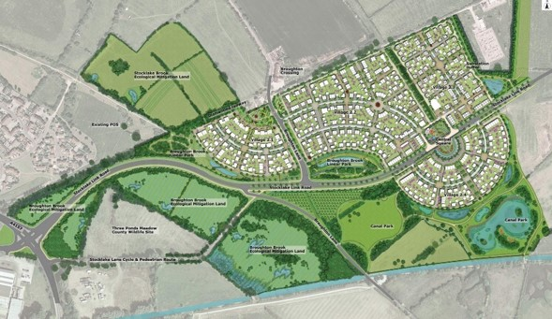
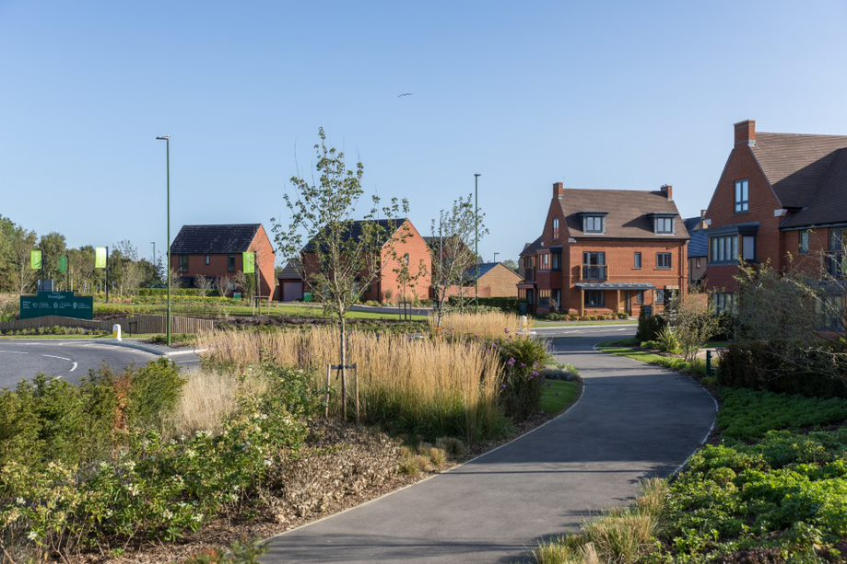
The Value of Habitats
Habitats are vital to wildlife + benefit people
2 ways to achieve BNG, a) more and/or b) better quality habitats
Use of a standardised statutory biodiversity metric
Contains all area-based and linear habitat types found on land & around coast
Habitats have different values + some are easier to create than others – seek advice
Enhancing existing habitat scores more highly than creating new habitat from scratch

Slide 6
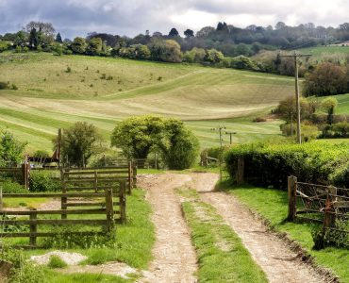
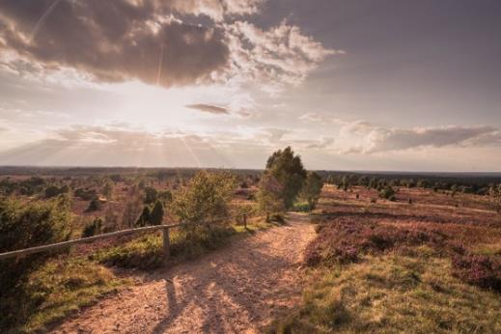
Mechanisms for Biodiversity Net Gain Delivery
Onsite (units)
Offsite (units)
Statutory Credits
Potentially in full or combination
Only if units not available
Delivered via habitat creation/enhancement via soft estate/green infrastructure/landscaping
Delivered ‘locally’ through new habitat creation/enhancement on land holdings or via habitat banks
Delivered through landscape-scale strategic habitat creation delivering nature-based solutions

Slide 7
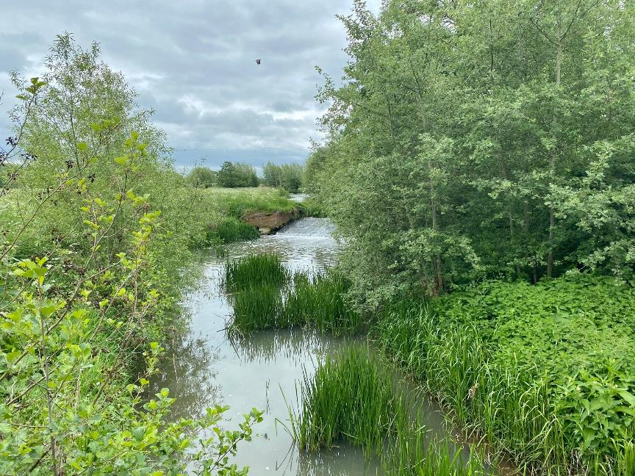
Biodiversity Gain Site Register
Purpose
To evidence the recording of off-site biodiversity gains
Ensure gain sites meet eligibility criteria
Safeguard against double counting of off-site enhancements
Provide transparency in BNG delivery in local areas.
N.B. – Any offsite BNG used must be allocated on the register
Notes:
The Register is not a marketplace or matchmaking service
Gain sites must
It is not compulsory to register

Slide 8
Top Tips
Consider early – site allocation/selection/design stage
Avoid high nature value sites if possible
Integrate nature into scheme design
Talk to the LPA early – use pre-app advice
Retain good existing habitat where possible
On or off-site or both? Consider strategy and pros and cons
Obtain data and advice
Involve maintenance/management contractors
Deliver local habitat priorities to achieve BNG more easily
Land on the net gain register can be used immediately

Slide 9
Thank You

