Slide 1
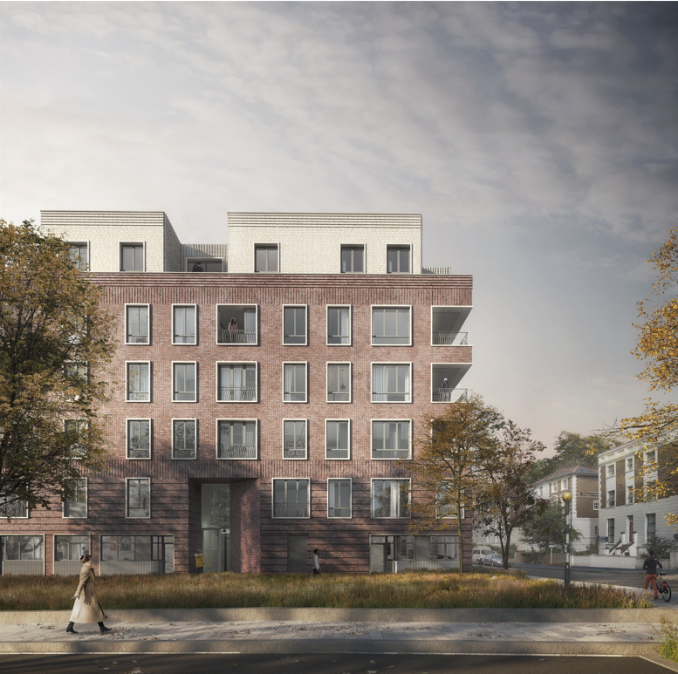
Camden’s
Community Investment Programme
Huw Jones
Head of CIP Development

Slide 2
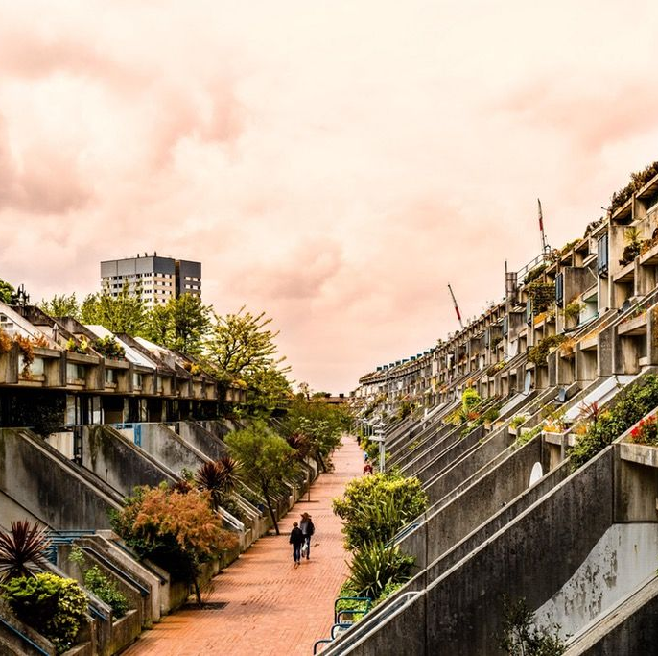
“We were working then not to do social housing but to do housing. Not to do a site, but to work on the idea of a piece of city to revitalise and work with the society that was there.”
Neave Brown, RIBA Gold Medal Winner 2018

Slide 3
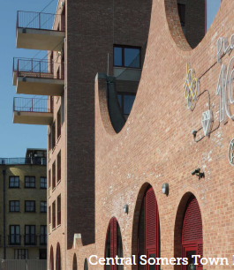
Camden gets building again
CIP Launched By Camden’s Cabinet in December 2010
Original target to deliver 3050 homes over 15 years
(1400 Affordable homes and 1650 homes for market sale)
Original objectives also included investment of £116m in schools and 9000m2 of improved Community
Floorspace
Current programme has risen to 4,850 homes with a total investment of £2.3bn.
CIP was a response to austerity and the axing of programmes such as Building Schools for the Future;
However HRA reform and funding / Localism Act changes around this time kicked off an expansion in Council House-building (“Direct Delivery”) across the country.
Camden has been at the forefront of this.

Slide 4
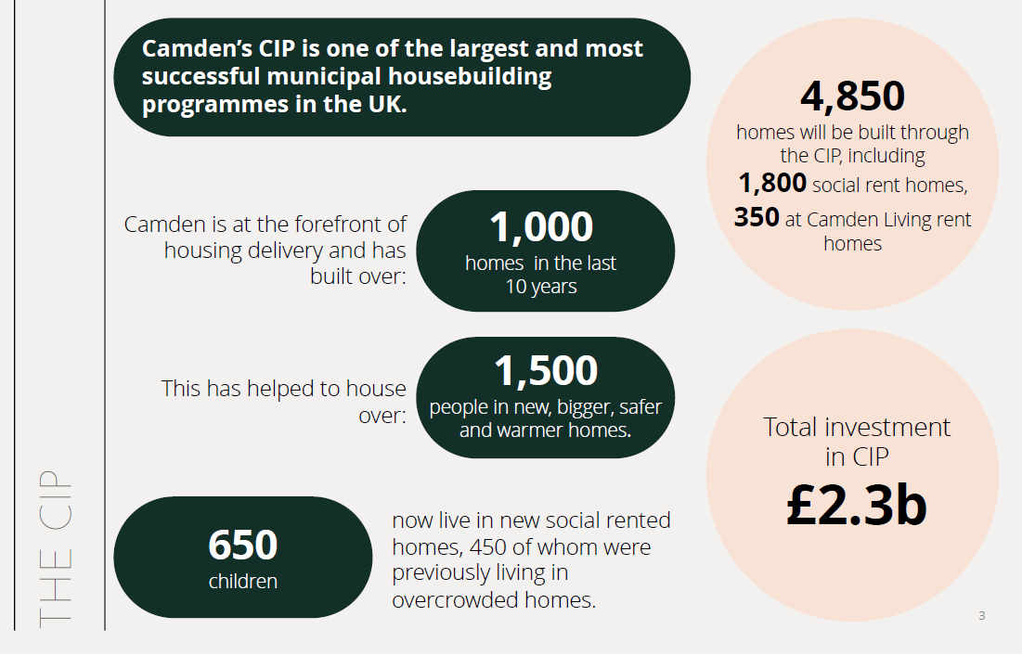

Slide 5
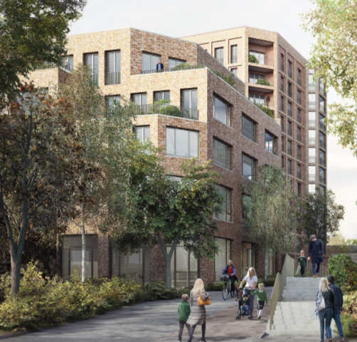
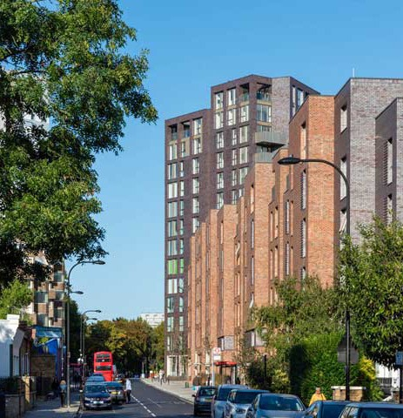
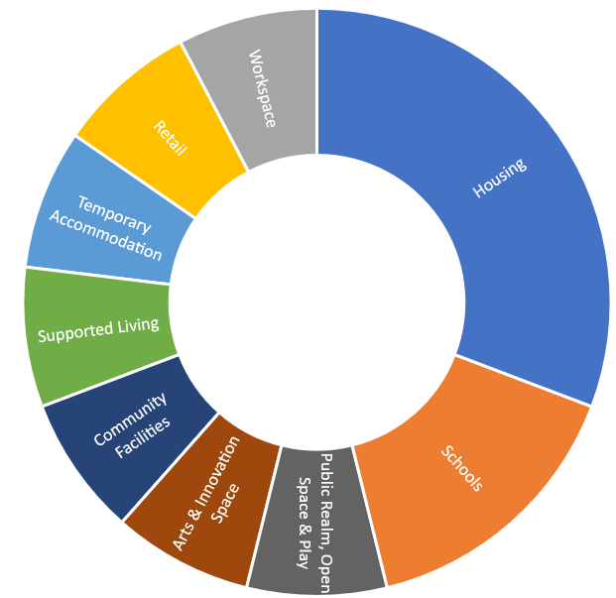

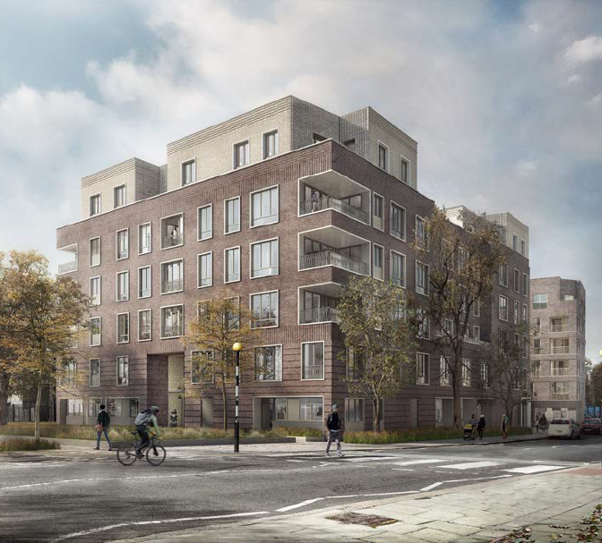
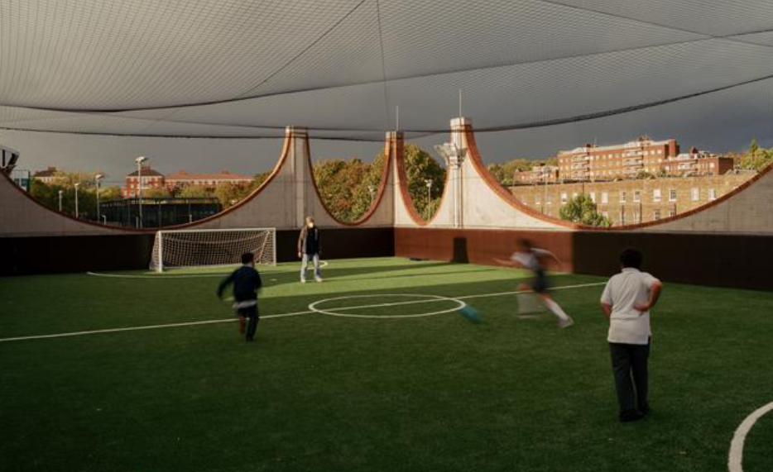
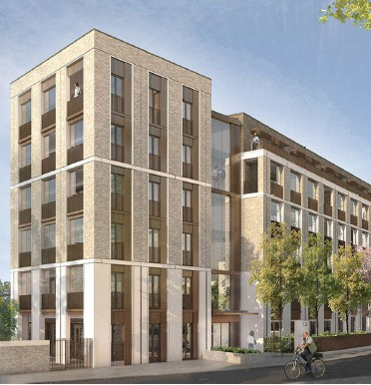
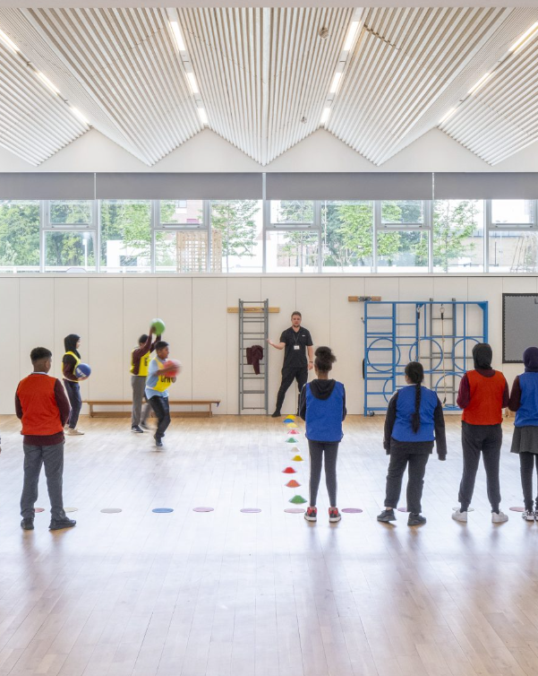
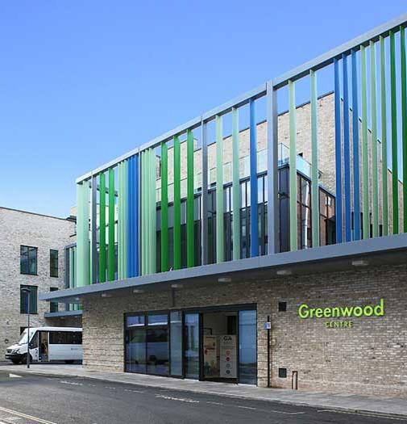
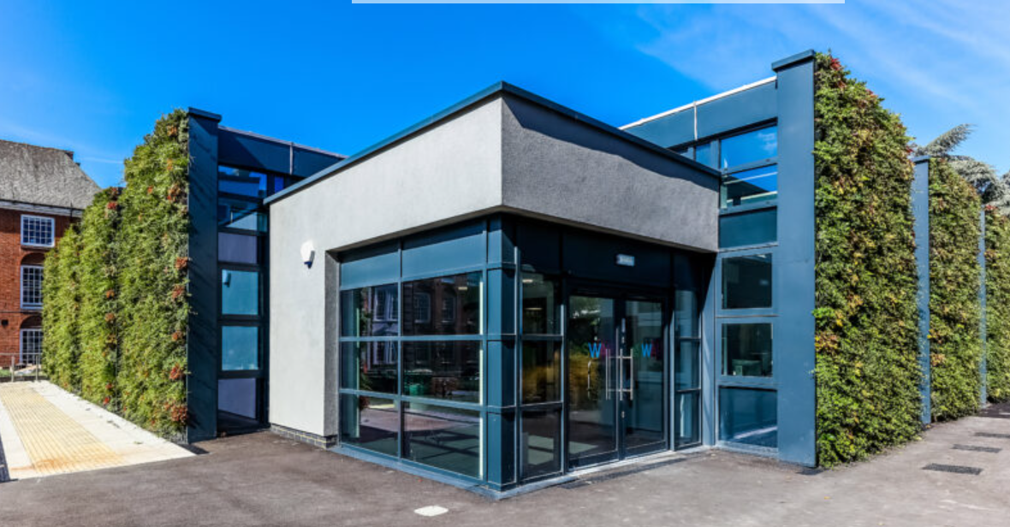
Mixed Use Development
Liddell Road Workspace
Abbey Road
Holmes Road
Hostel
Agar Grove
Tessa Jowell Court
Charlie Ratchford
Edith Neville School
Greenwood Centre
LaSWAP 6th Form

Slide 6
Why should Council’s build?
Use land assets and local leadership to leverage growth and regeneration;
Council’s building can often achieve greater numbers of affordable housing than other developers;
Money spent on construction projects can be linked to genuinely impactful social value, jobs, training and local economic activity;
Council’s can solve multiple challenges – overcrowding/under-occupation; stock condition; Affordability and energy performance; area regeneration and high street renewal
Council “in-house” development teams build experience in major project delivery which is invaluable for unlocking opportunities & funding as they arrive.

Slide 7
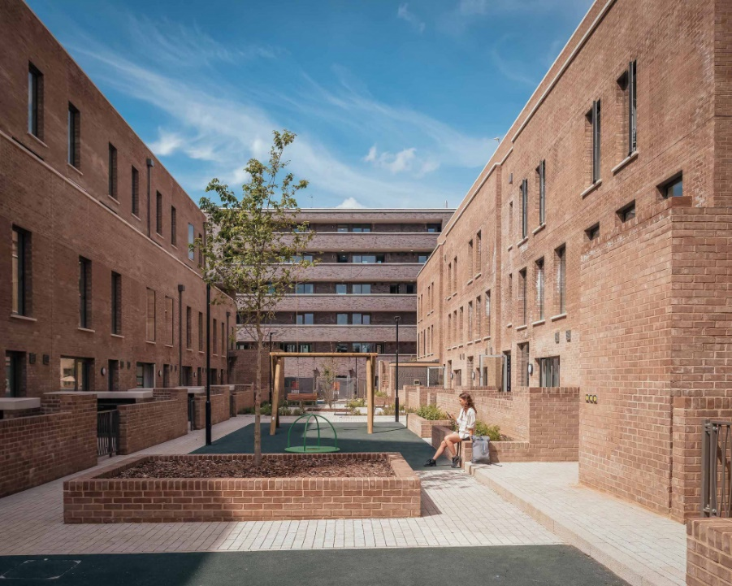
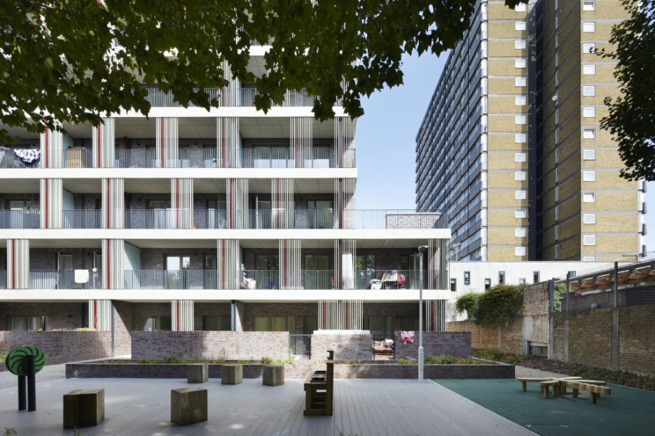
Our Principles
  Bold, ambitious and rigorous – the Community Investment Programme is bold and ambitious in tackling the housing crisis – we will make the best use of public resources and make the most of our assets and resources
  Transparency and openness – we work in the open and work with residents and communities before, during and after the development of schemes
  Participation and capacity building – we build with the resident voice and communities alongside us as partners – they shape schemes and our schemes provide people with skills for the future – including jobs and apprenticeships
  Increasing the number of good homes in our Borough as quickly as possible – we want to build more homes and better homes – moving families out of overcrowded, poorly designed properties into homes and places that are healthy, safe and affordable
  Equality and housing justice – we tackle housing inequality and the health and wellbeing impacts of living in poor quality housing as an issue of social justice
  Tackling the climate emergency – our homes are sustainable and we will build for a net zero future
  Affordability now and for the future – our homes are affordable for those who live in them – and we build homes that reduce energy bills so that families incomes are protected

Slide 8
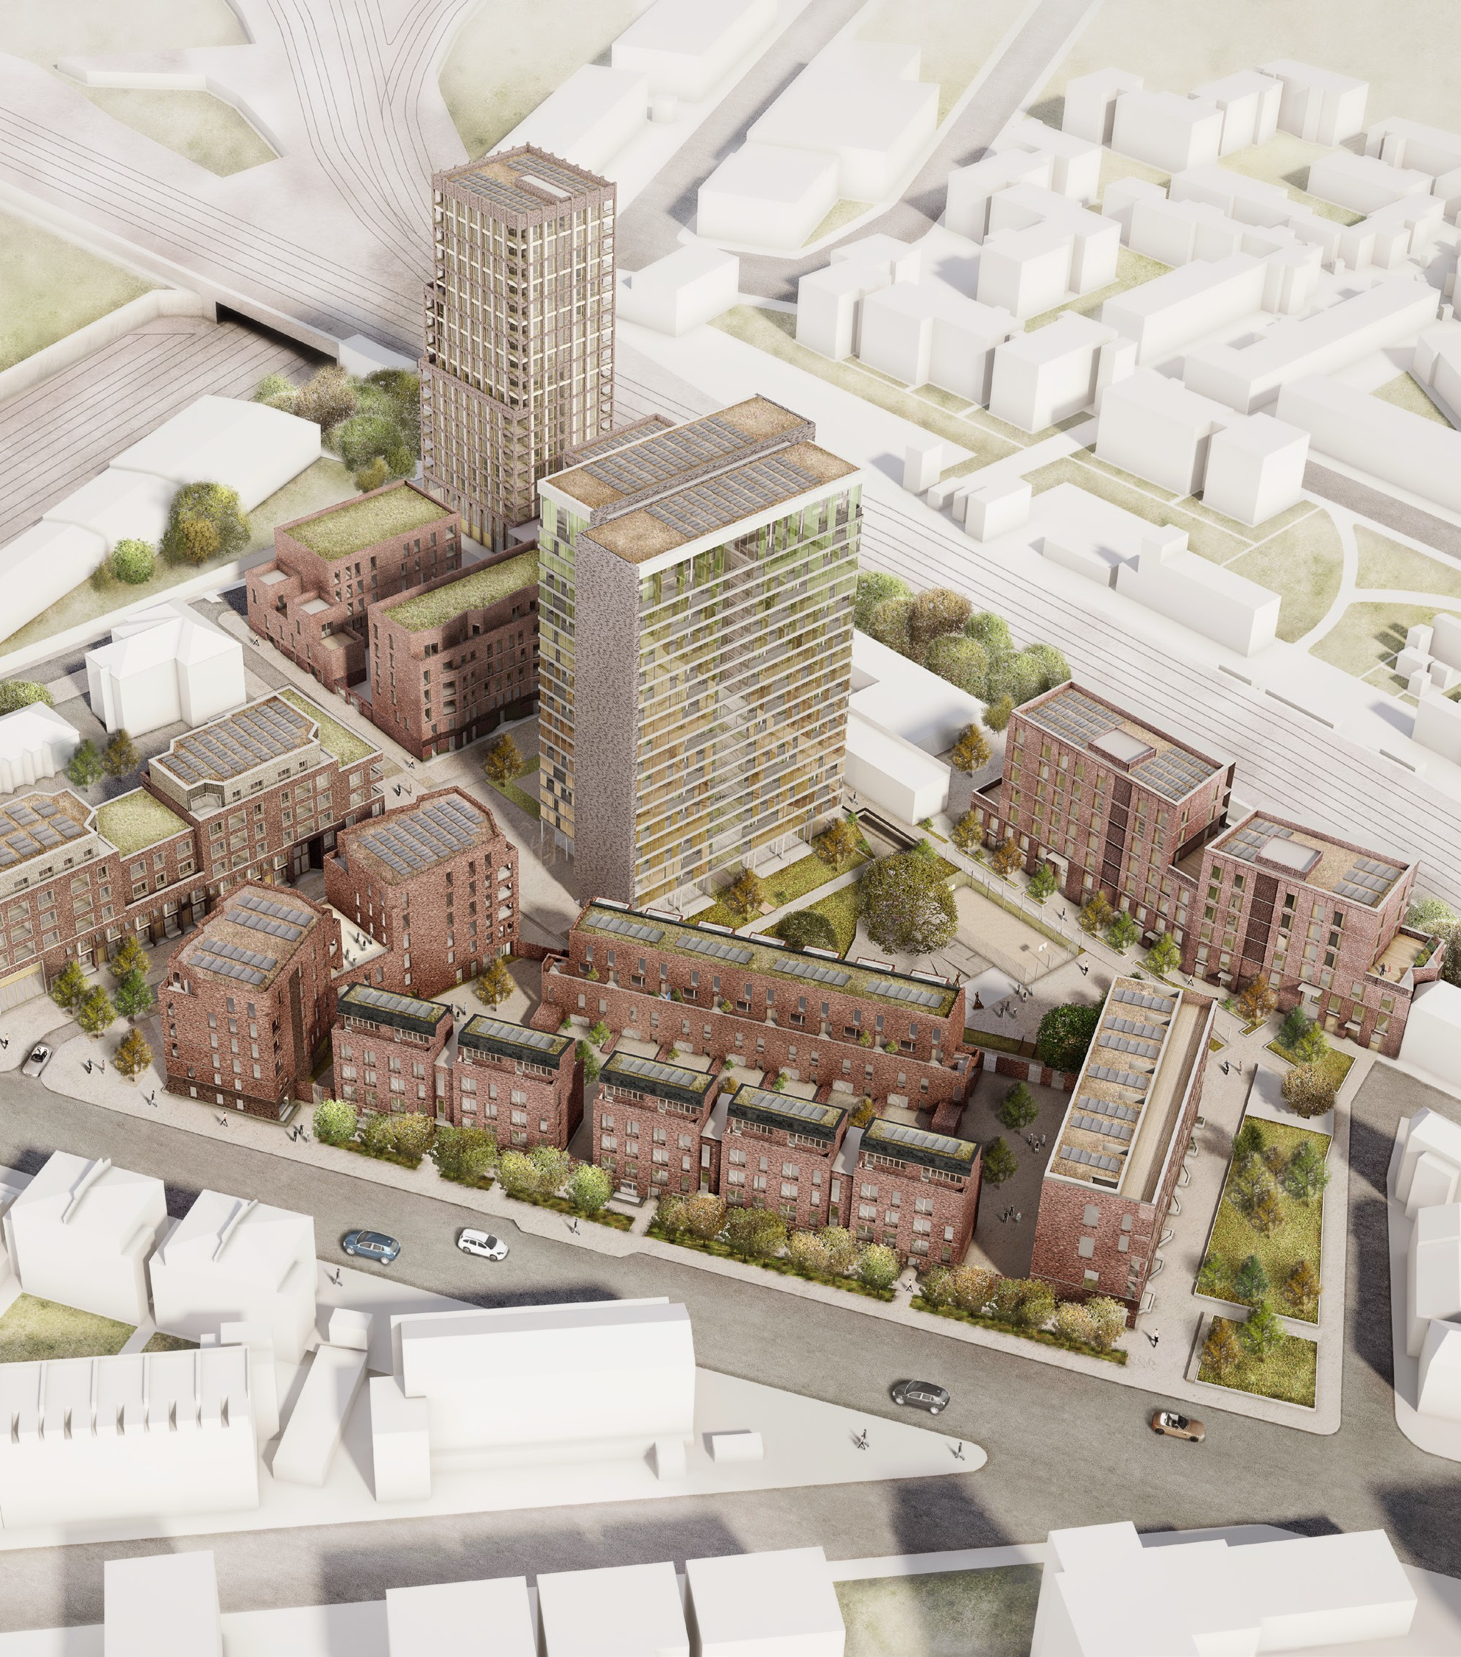
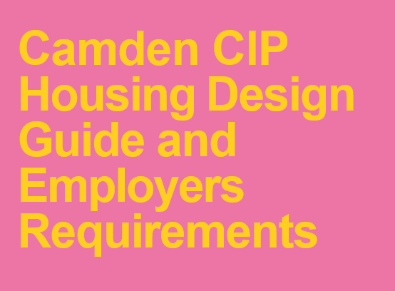


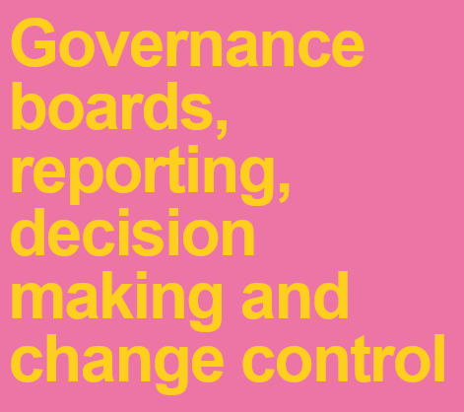



Managing CIP: Design standards, benchmarking and controls

Slide 9
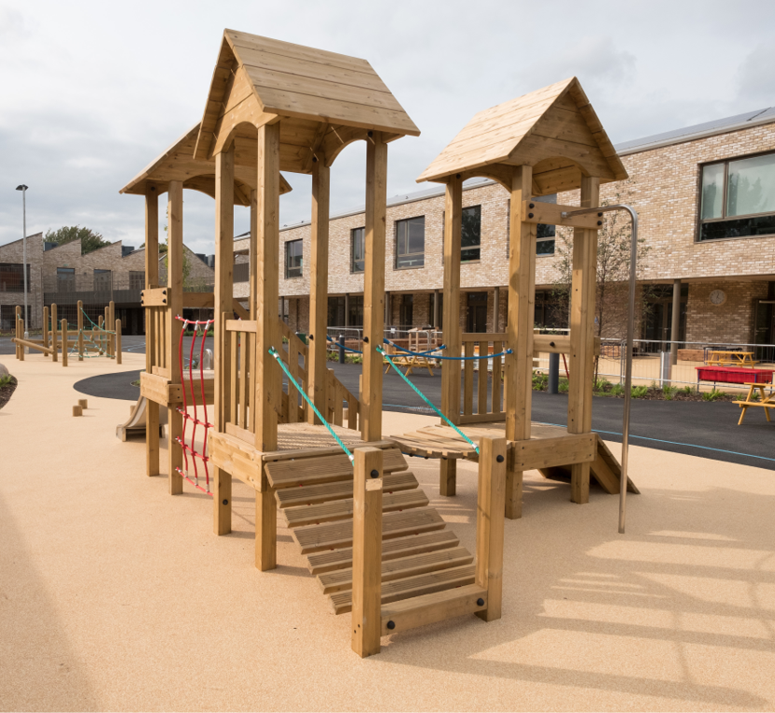
Case Studies

Slide 10
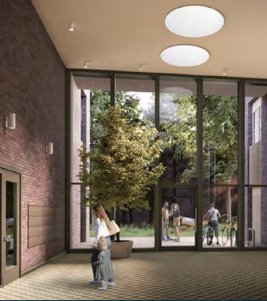
Agar Grove Regeneration

Slide 11
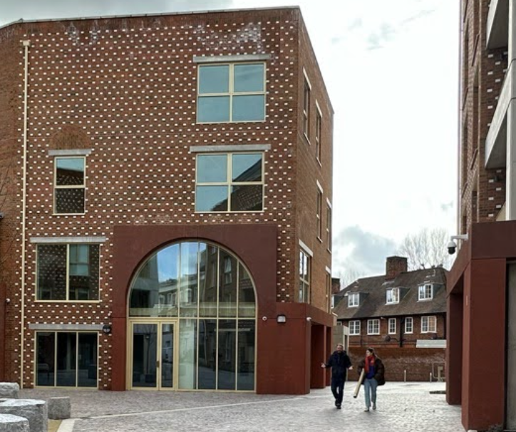
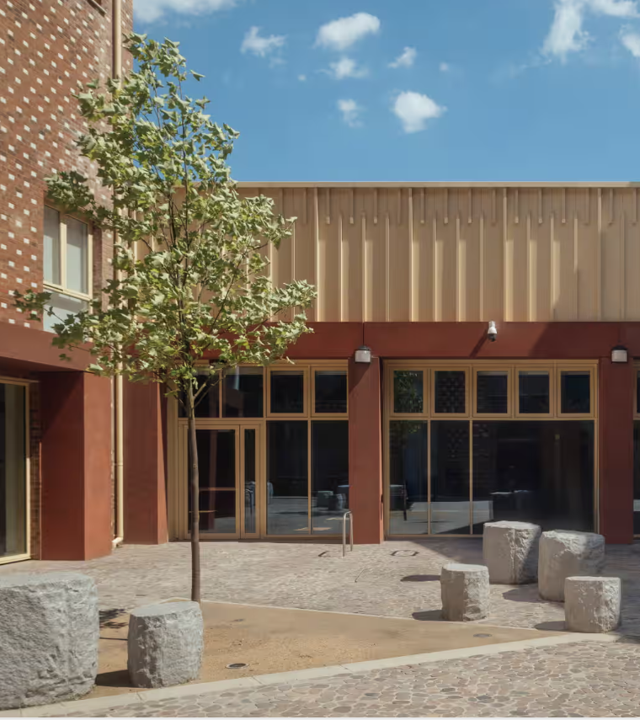
Highgate Newtown

Slide 12
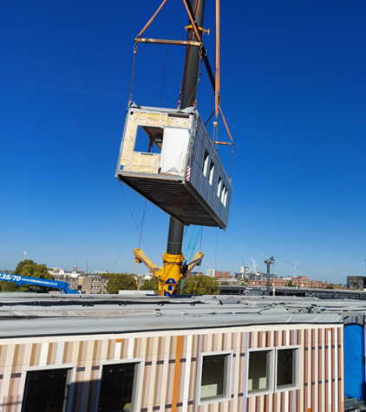
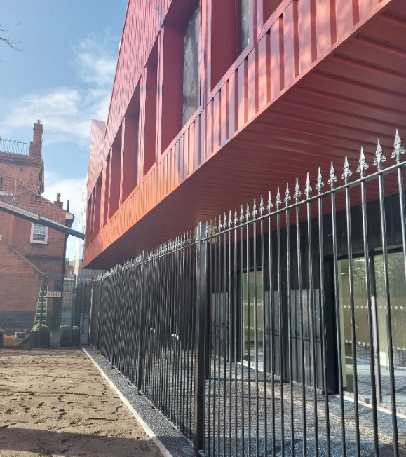
Euston Skills Centre

Slide 13
Looking forward
Partnerships & Development Agreements
Camden Living RP
Building Safety Act / Climate Crisis
Emerging priorities – Temporary Housing
1.5 Million Homes?

