Slide 1
Jacqui Taylor
Lead Councillor for Housing at St Albans District Council
February 2025

Slide 2
Projects
Redevelopment of sheltered housing
Building new council homes on existing council owned HRA land
Housing strategy – housing associations
Decommissioning of tower block
Development of affordable housing in a mixed commercial development in city centre
Local Authority Housing Fund (LAHF)
Social housing decarbonisation (warm homes)

Slide 3
New Housing - former sheltered
Hawking’s House, St Albans
21 x 2-bed flats
7 x 1-bed flats
Completed January 2020
Partnership with Catalyst Housing Association for social rent

Slide 4
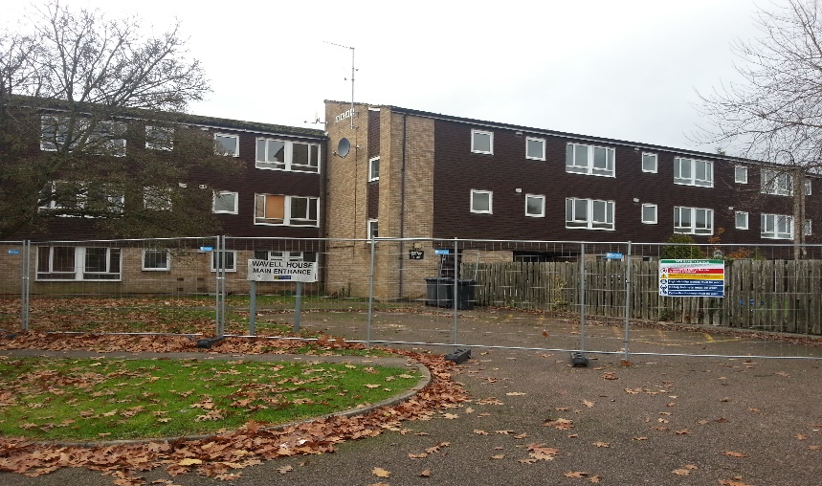
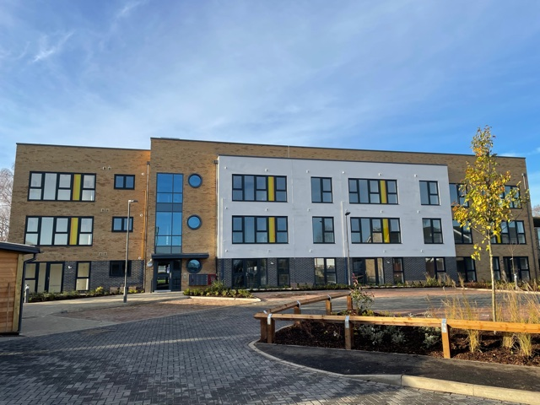
New Housing - former sheltered
Warner House, St Albans
12 x 2-bed flats
12 x 1-bed flats
Completed November 2020
Council owned social rent for over-55s

Slide 5
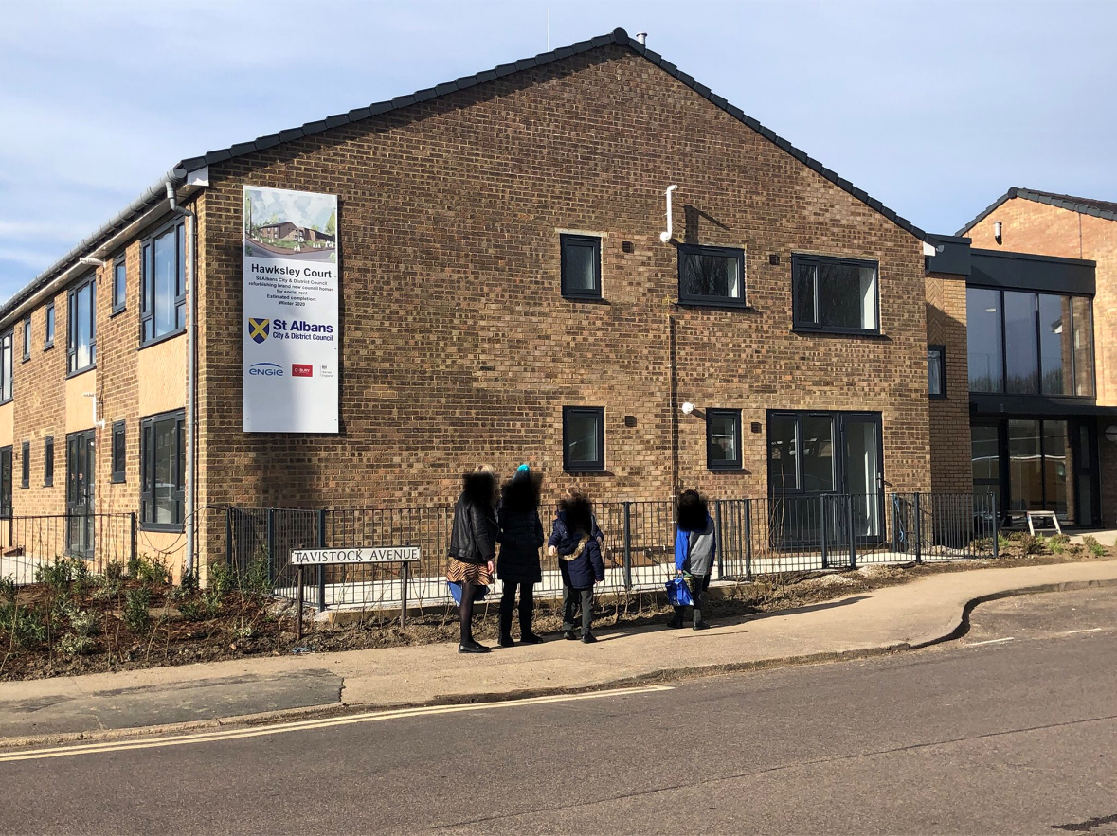
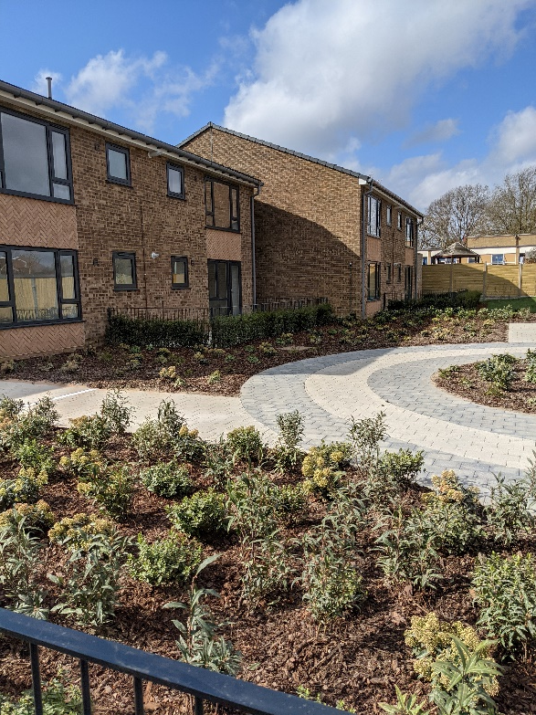
New Housing - former sheltered
Hawksley Court, St Albans
- 4 x 2-bed flats; 14 x 1-bed flats
Completed March 2021
Council owned general needs social rent

Slide 6
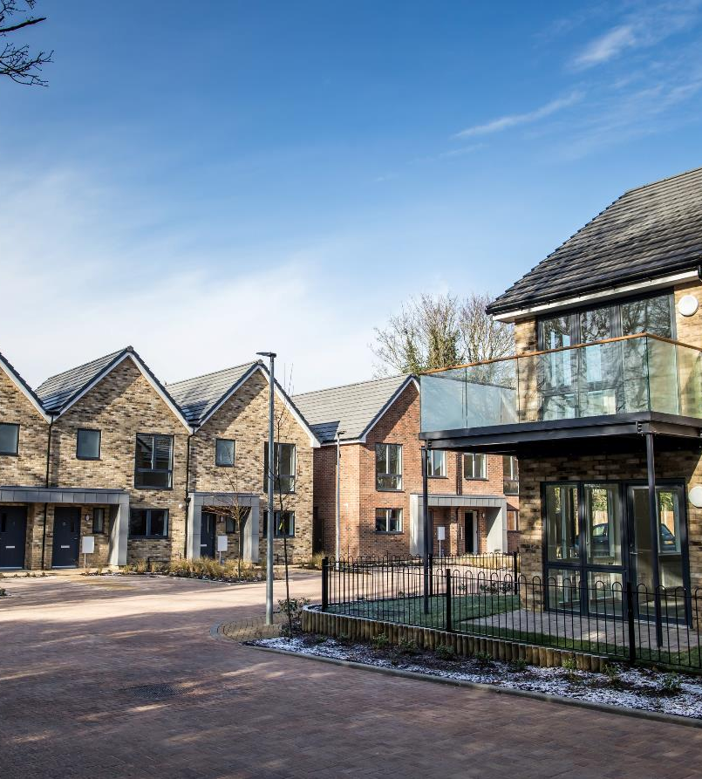
New Housing - former garage sites
Morris Green & Allen Green, Sandridge
4 x 3-bed houses
3 x 2-bed houses
4 x 2-bed flats
4 x 1-bed flats
Completed February 2019

Slide 7
New Housing - former garage site
Holyrood Crescent, St Albans
- 2 x 2-bed houses
Completed December 2021
Includes air source heat pumps (no gas)

Slide 8
New Housing - former garage site
Viking Close, Harpenden
Completed November 2023
4 x 3-bed council owned social rent homes
6 properties leased to local charity for supported living

Slide 9
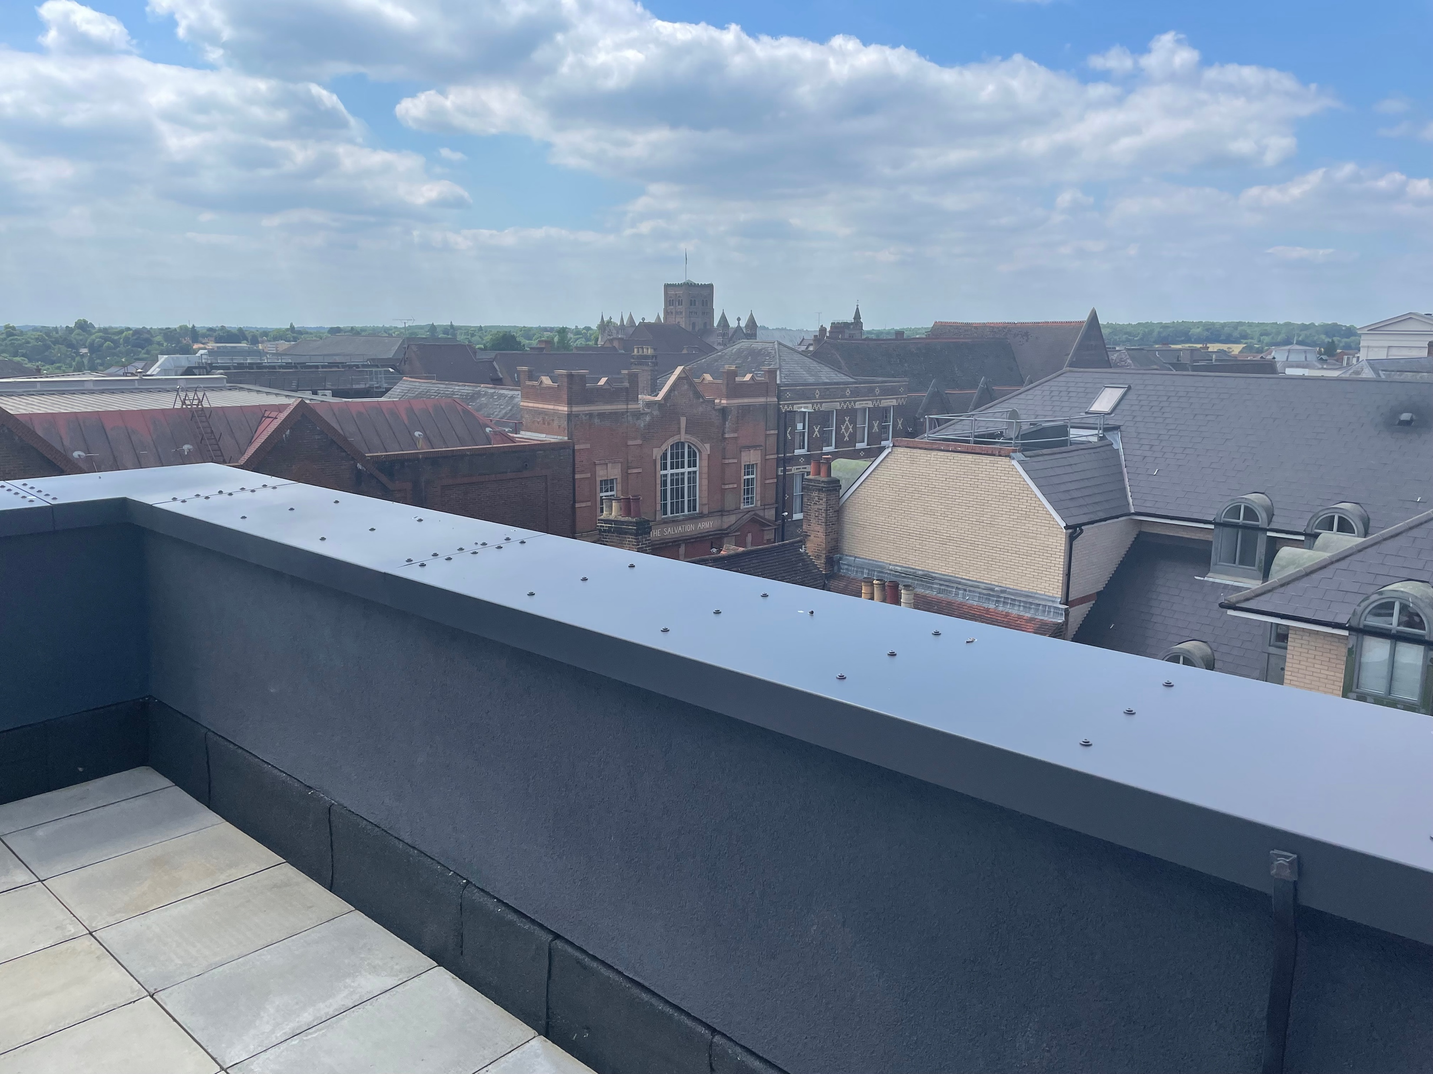
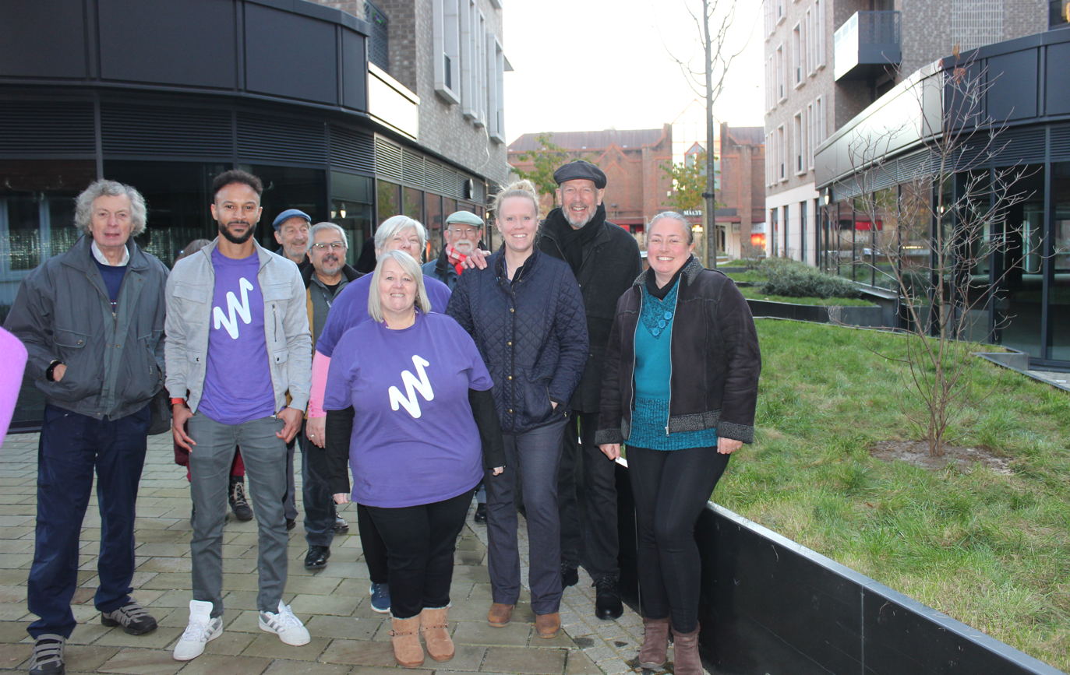
New Housing - city centre
Jubilee Square, St Albans
- 33 flats for social rent
- 60 flats shared ownership with Watford Community Housing
Completed July 2024
Mixed commercial development in city centre
Former police station

Slide 10
New Housing on HRA land
The Hedges, St Albans
- 6 x 3-bed houses; 6 x 2-bed flats all social rent
Completion due March 2025
Former temporary accommodation site
Heat pumps, solar panels, EV charging

Slide 11
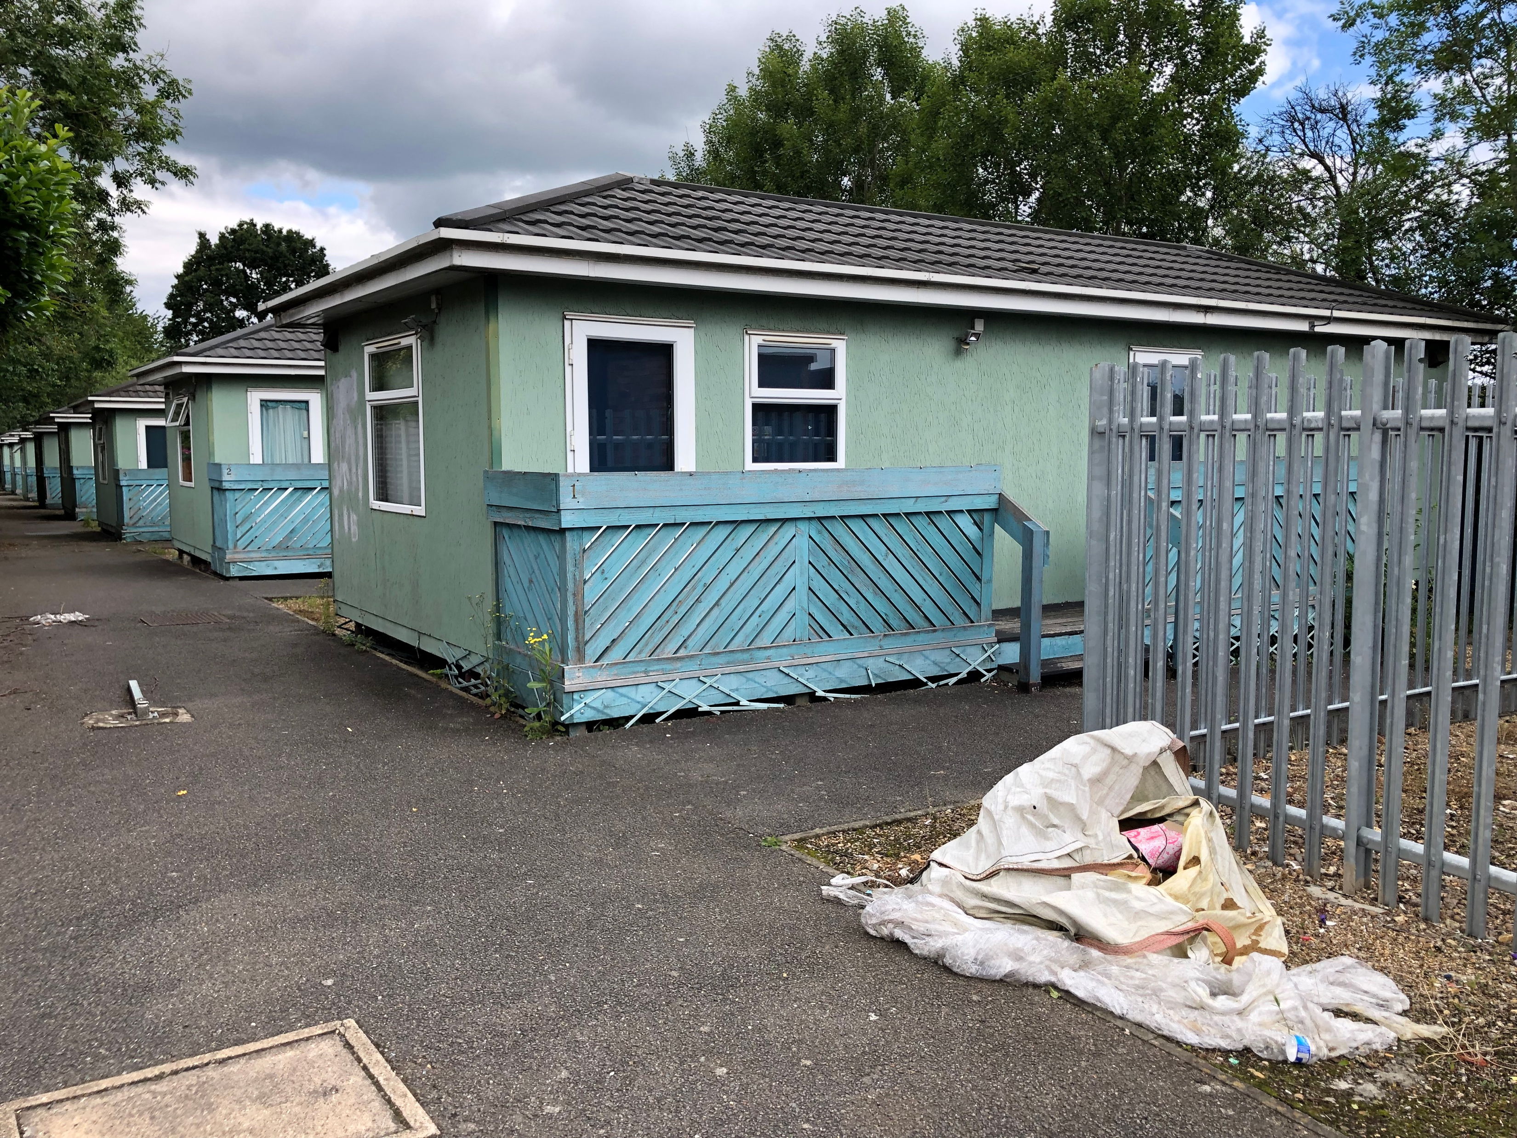
New Housing on HRA land
King Offa, St Albans
- 11 x 3-bed houses
- 2 x 4-bed houses
- 1 x 2-bed bungalow
all for social rent
Completion due June 2025
Former pub & temporary accommodation site
Heat pumps, solar panels, EV charging

Slide 12
Social Housing Decarbonisation
Before
After
‘Airey’ houses built during a post-war housing boom with prefabricated concrete and have a particularly low energy rating

