Slide 1


Slide 2

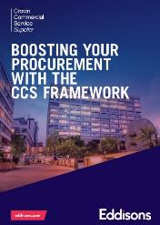


















ABOUT EDDISONS
Eddisons is advising public sector across the whole development and asset management lifecycle
Direct call offs via Crown Commercial Services, Homes England and ESPO

Slide 3
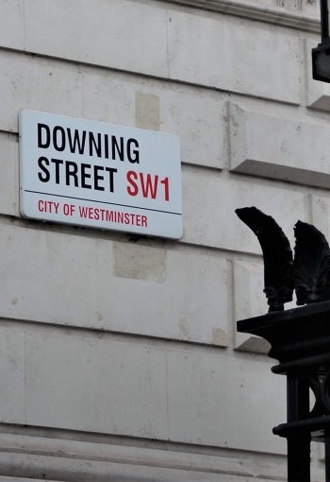
GOVERNMENT AGENDA
Government has set a target of 300,000 new homes pa for the duration of this parliament
More than 200 councils would see their housing targets increase
Land released in the Green Belt will be subject to the government’s ‘golden rules’, 50% affordable homes
The government will publish NPPF revisions before the end of the year, so policy changes can take effect as soon as possible
Government will review Right to Buy more widely

Slide 4
GOVERNMENT INTERVENTION
Funding Programmes are coming to an end soon
LAs frantically spending monies by March 2026 to meet grant spending targets eg levelling up etc
As programmes wind down, we are still waiting to hear new programmes albeit LAHF was announced recently
Future High Street Fund | ✗
Towns Fund | ✗
Levelling Up Fund | ✓
Housing Infrastructure Fund | ✓
Affordable Homes Programme (AHP) 2021 to 2026 | ✓
Local Authority Housing Fund | ✓

Slide 5
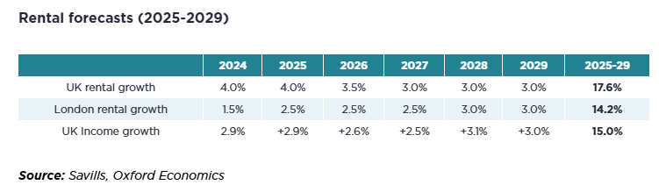
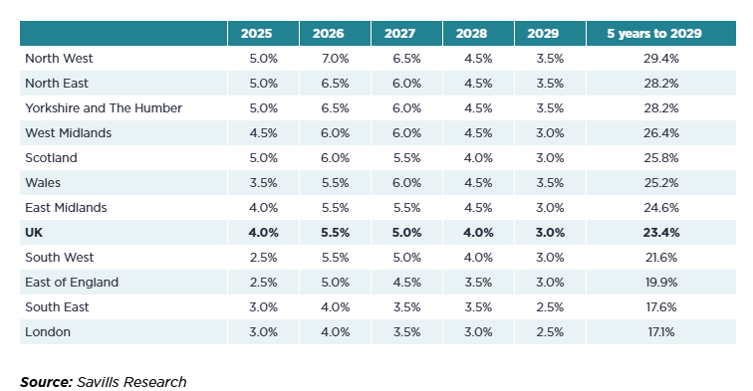
MARKET IMPACT
Housing capital and rental growth forecasted to continue to grow
According to a report by Better Society Capital.
  Pension funds provided one-fifth of all investments (£10billion)
  Government bodies and local authorities 8% each.
Funds such as Legal & General has raised £510 million for its affordable housing investment strategy as part of the second close of its Affordable Housing Fund, launched in July 2024.

Slide 6
FUNDING STRUCTURES
There are a whole host of delivery structures - Direct and Indirect
Increased cost of Prudential Borrowing is creating viability challenges
Private sector intervention will need to increase to deliver housing targets
Intervention Options Comparison
COST
£
TF
TIF
IS
ABV
PB
Key
RM Regeneration Management
TF Grants eg Towns Fund
ICO Integrating Community Ownership
ABV Asset Backed Model
TIF Tax Increment Financing
IT Income Strip Lease
PB Prudential Borrowing
MDP Master Developer Partner
MDP
ICO
RM
Low Intervention Risks
High Intervention Risks

Slide 7
PRUDENTIAL BORROWING
Changing Funding Climate
Long term Interest rate risen to 6%
Funding projects proving to be challenging without grant support

Slide 8

INCOME STRIP LEASE
60s, 70s and 80s Local Authorities facing higher costs of debt pursued income strip lease structures to facilitate development such as shopping centres and affordable housing
Investor community would bring significant capital and development expertise
With schemes becoming less viable do we need to seriously consider a return to this type of funding model?

Slide 9
INCOME STRIP LEASE CASE STUDY
The Council procured through a competitive tender process awarded a Finance, Design and Build contract.
Waypoint Government Income Fund with Kajima Partnerships Ltd and Tolent were awarded the contract. The Council income strip structure involved:
  Agreement to lease: Obliges the partner to DBF
  Head Lease: Once the condition of the agreement for lease are met the Head Lease is enacted. This is the transfer of land from the Council to the investment partner.
  Sub Lease: Once the buildings are completed they are handed back to the Council under the “Occupational Lease”
The schemes have also benefited from investment from Homes England’s Shared Ownership and Affordable Homes Programme.
Council Freehold
Agreement to Lease
Head Lease Typically 125 years term at peppercorn
Sub Lease Typically 35 – 50 yrs Years (reversion reverts to Council at end of term)

Slide 10
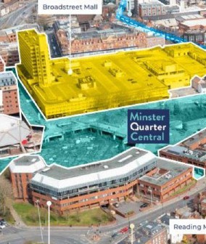
MASTER DEVELOPER PARTNER
Local Authority can lean on developer market to forward fund housing
Housing Infrastructure Fund £2m grant
Land receipt paid
Developer agreements involved:
  Development Agreement - obligation to obtain planning and fund development in a timely manner
  Ground Lease - Grant of head lease to allow funding of construction works
  Freehold Transfer - On satisfactory completion of works.
  Includes overage in the event developer profit exceeds blended target Rate of return

Slide 11
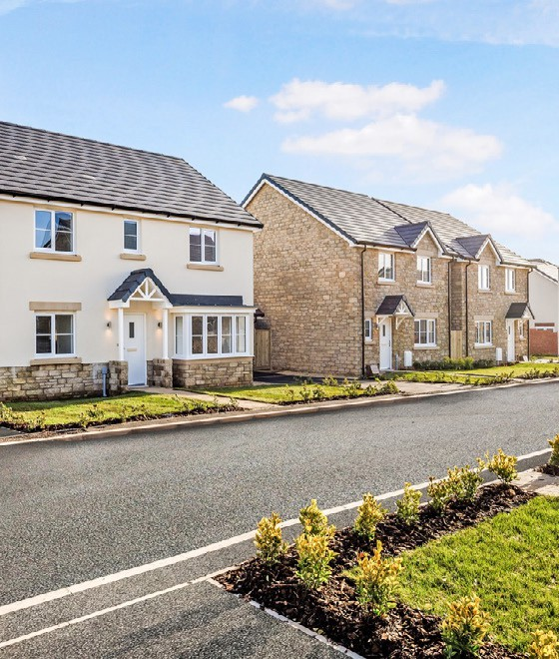
CONCLUSIONS
Income Strip Lease offers a route to fund development
Investor appetite is strong in the housing sector
Risk transfer

