Slide 1
APSE Energy 2024
Glasgow City Council Model for Climate Investment
Gavin Slater, Head of Sustainability, GCC

Slide 2
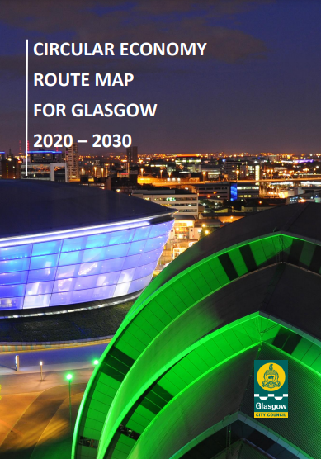

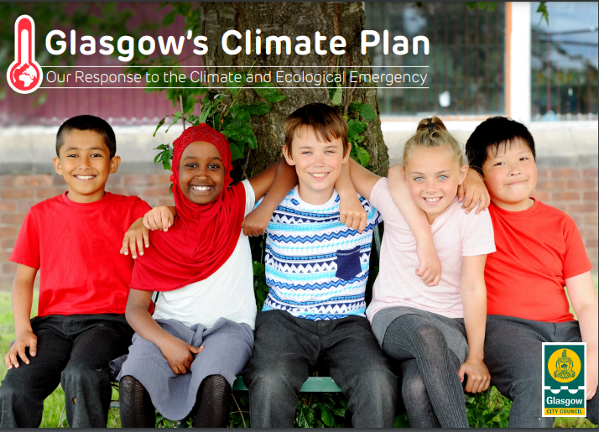
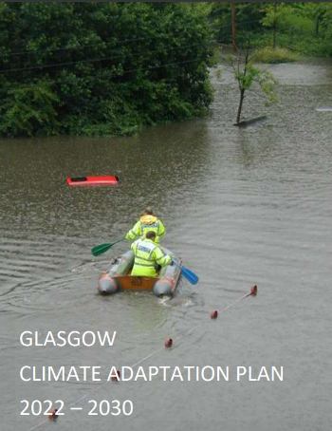
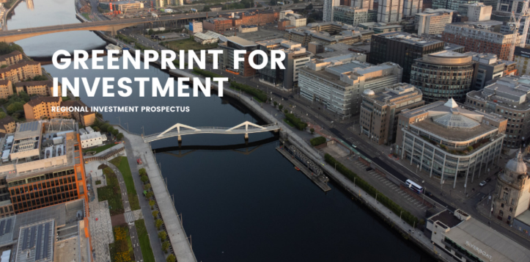

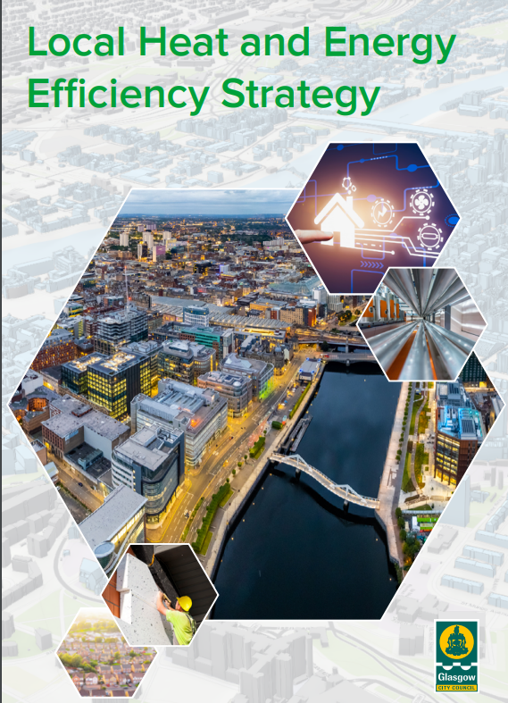

1. Introduction
Glasgow’s Climate Journey
Sustainable Glasgow launched in 2010
Climate and Ecological Emergency declared in May 2019
Net Zero Carbon Target 2030 established
Climate Plan launched in 2021
COP26
GreenPrint for Investment & LHEES

Slide 3
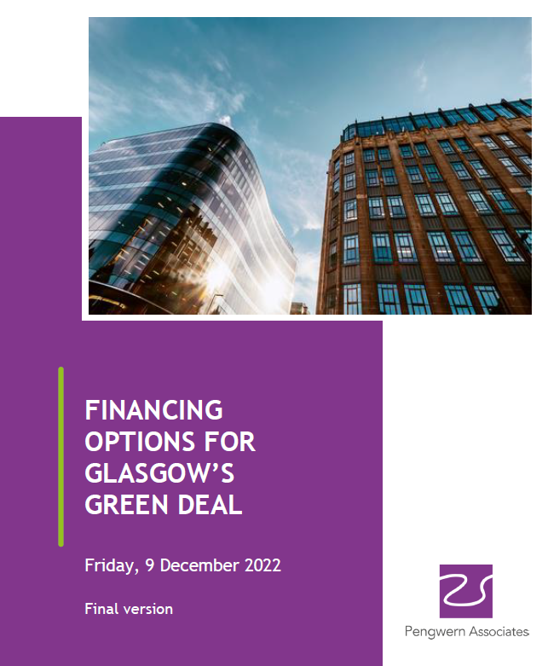
2. Background
Net Zero Ambitions cost in excess of £40bn
Climate ambitions outweigh funding available
Target dates are approaching, accelerated delivery required
Private sector offering to fund – no mechanism to accept funding
Resource shortage in public sector for project delivery
Project pipeline needs to be business case ready
LHEES ~£10-15bn to deliver

Slide 4
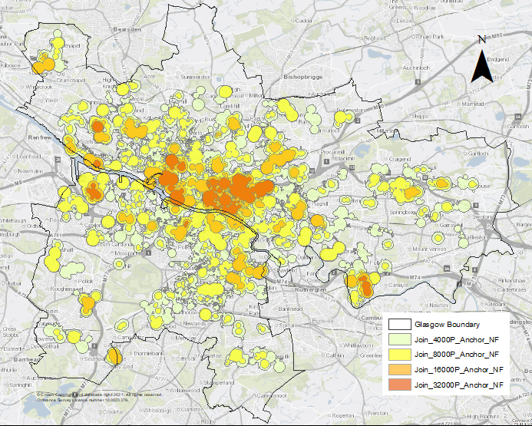
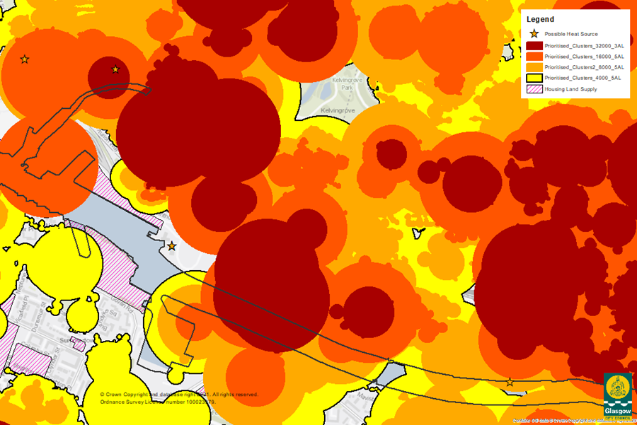
3. LHEES
LHEES Scope
“a citywide assessment of where certain interventions may have the greatest impact on fuel poverty and carbon emissions”
Three focus areas
  Heat Networks
  Energy efficiency improvement to tackle fuel poverty
  Individual or Communal solutions
  Zoning of City for heat networks

Slide 5
4. Climate Investment
Model for Climate Investment
Two Parts to proposal that, whilst distinctly different and requiring separate processes to be pursued, are inherently linked:
A Delivery Vehicle which will create the conditions that enable the private sector to work with the Council in bringing forward infrastructure projects that are within the Council’s control, business case ready and investable; and
A Climate Investment Vehicle for the city/city region that would be wholly controlled externally. Similar vehicles have been created in other regions of the UK and consist of private finance consortiums, often including pension funds, that commit to funding investable infrastructure projects which demonstrate a return on investment, often over a longer timeframe.

Slide 6



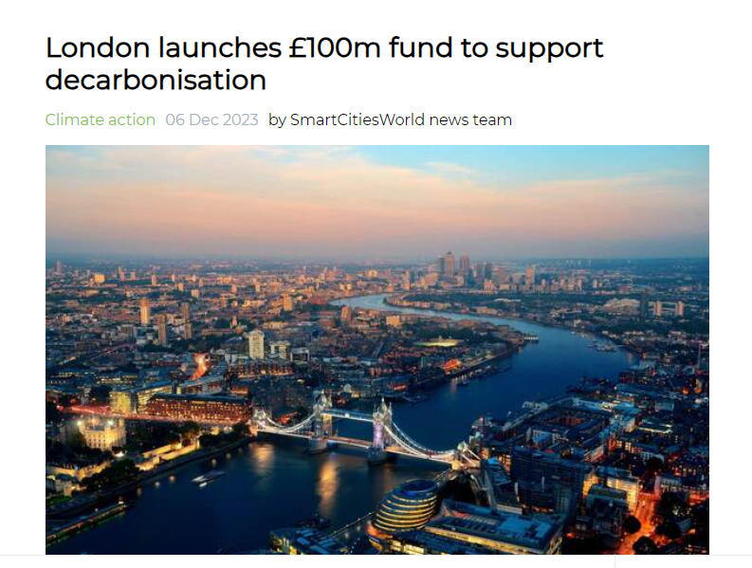
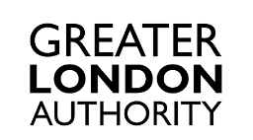

5. Example Models
INNOVATIVE FINANCING AND DELIVERY METHODS

Slide 7
6. Climate Delivery
Model for Glasgow
Delivery Vehicle
strategic approach to control and manage investment in the city
investigating and implementing viable and appropriate business models
articulates what the city wants to achieve, assets in scope, and minimum requirements model must achieve
builds upon LHEES
public private partnership or concession agreement will be explored
additional social value, community involvement and ensuring a Just Transition, critical

Slide 8
6. Climate Investment
Model for Glasgow
Investment Vehicle
creation of an investment vehicle for the city/city region
fund to address the funding gap as well as providing city partners with the opportunity to progress projects that otherwise may not be able to be delivered
separate governance and decision-making process from the internal Delivery Model and, to all intents and purposes, operated in the same way as a Fund Management company

Slide 9
7. Climate Investment
Team
Budget Approved – circa £4m over 2 years
Specialist team to be appointed recognising the complexity of the project
Given the innovative nature of the project internal and external specialists are required
Robust governance structure required to support the project
Need for flexibility in design of team to allow other areas to join/programme to flexed

Slide 10
8. Climate Investment
Team – Governance
CAC
Net Zero and Climate Change Progress Monitoring Policy Committee
Climate Investment Board
Sustainable Glasgow Partnership Board
Climate & Sustainability Board
Political Oversight Group
Head of Sustainability
Climate Investment PMO
Regional Sustainability Projects
Climate Investment Vehicle
Delivery Vehicle

Slide 11
9. Moving Forward
Conclude procurement of legal and finance support
Scope Finalisation (including Vision, Mission and Goals)
Commence construction of business case
Assets and Funding Review
Conclude technical heat zone characterisation

Slide 12
Thank you

