Slide 1
Flooding and Coastal Erosion
Managing emergencies on the Isle of Wight

Slide 2
IWC Coastal and Flood Risk
Coastal Protection Authority
The council has a vested responsibility for controlling coastal erosion under the Coast Protection Act 1949
The Environment Agency (EA) is the primary sea defence authority for England, while Coast Protection Authorities have two functions;
  regulating the protection works of others (such as landowners), and
  promoting their own schemes part-funded by grant from the EA
Local Lead Flood Authority
We are responsible for flood risk management and have developed a local flood risk management strategy. The strategy provides information about potential flood hazards including:
tidal
river
surface water
sewer
groundwater.

Slide 3
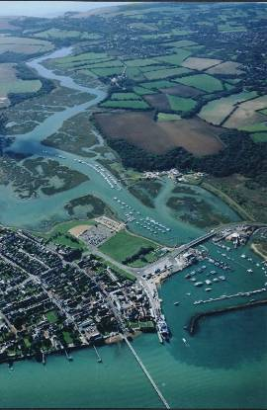
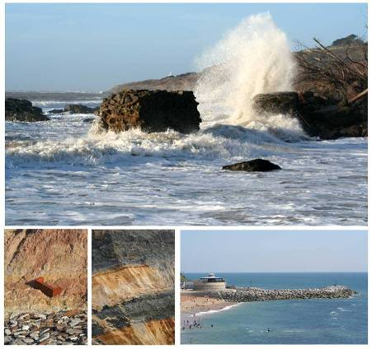
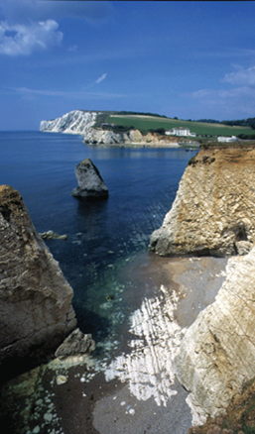
The Island Coastline

Slide 4
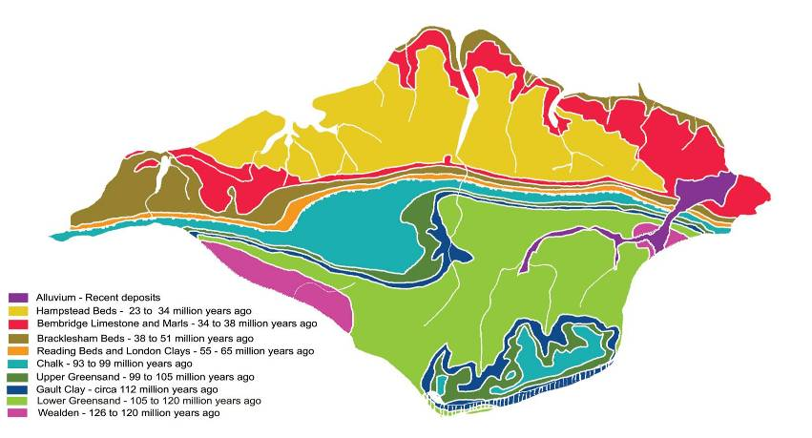
Island Geology

Slide 5
Becoming an Island
During the last ice age, most of the northern hemisphere was buried under glaciers.
Around 10,000 years ago the climate changed. The world started to warm up.
The water from the glaciers melted and flooded the river valleys that are now the English Channel and the Solent.
Rapid flooding and changing weather eroded the chalk ridge between Dorset and the Island.
The extreme weathering and erosion during this time has helped to form the shape of the Island and continues to do so today

Slide 6
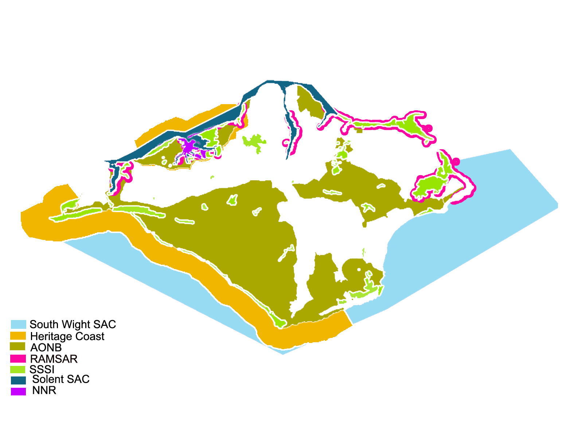
Conservation Area

Slide 7
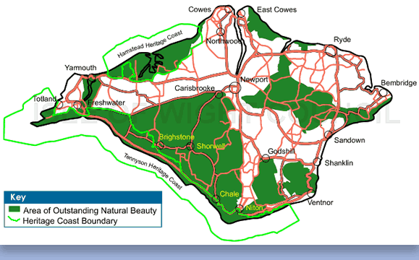
AONB
The Isle of Wight AONB was designated in 1963 and covers approximately 189 square kilometres, about half of the Island.

Slide 8
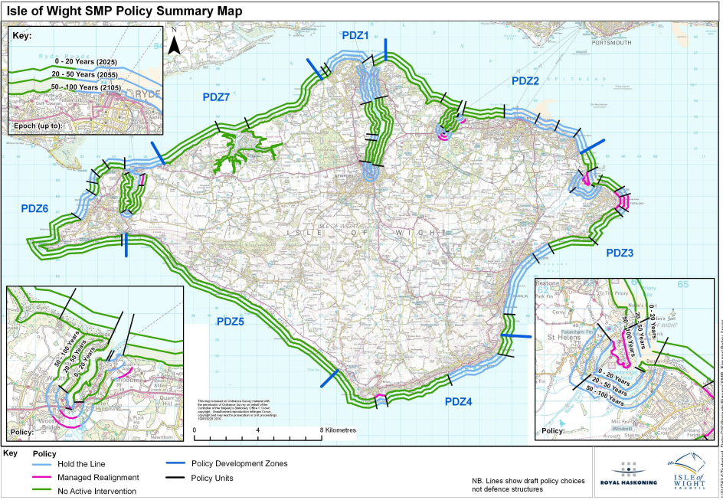
Coastal defence policy
The coastline of the Isle of Wight including estuaries is approximately 165km in length
22.2 (km) (13.8 miles) of Hard Coastal Defences including associated promenades, esplanades and railings.
181 off Groynes
51 off Navigation Aids
62 off Slipways (61 off concrete – 1 off Timber)
157 off Step Blocks (155 off concrete – 2 off Timber)
21 off Storm Gates
9 off Winter Storm Board Locations
5 off Access Ladders
3 off Outfall structures
Cliff drainage various locations

Slide 9
Managing the Coastline
Plans and Strategies – Planning Policy Team
Shoreline Management Plan 2011
Sets current shoreline management policies for the entire 168km of coastline and estuaries on the Isle of Wight. The plan assesses coastal flood, erosion and landslide risks over the next 100 years, and identifies where these risks can be reduced.
Includes stating which areas can be defended, which cannot, where risks remain, and where the coast will continue to evolve naturally.
West Wight Coastal Flood and Erosion Risk Management Strategy 2017
A Coastal Strategy for the 84km of coastline between Freshwater and East Cowes (including Freshwater, Totland, Colwell, Yarmouth, Western Yar Estuary, Bouldnor, Newtown, Gurnard Marsh, Gurnard Bay, Cowes, Medina Estuary and East Cowes).

Slide 10
Coastal Protection Management
IWC Coastal Protection – rev budget £80k pa
47 per cent of IW defences are maintained by IWC (22km in total)
Planned & reactive maintenance
Monthly walkover inspections defects and safety repairs
Capital programme urgent works
Emergency Works
Oversight of MMO exempted coastal protection activities
Coastal Partners SLA (Havant CC)
  Annual T98 inspections of all IWC assets
  Project Management Ventnor Urgent Works
Environment Agency MoU - £60m
  Major Capital Schemes
    Ventnor Slope stabilisation and coastal protection
    Shanklin sea defences repair upgrade
    Yaverland sea defences repair upgrade
    Embankment Road repairs
  Property Flood Resilience – E. Cowes

Slide 11
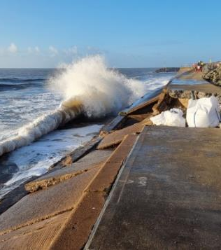
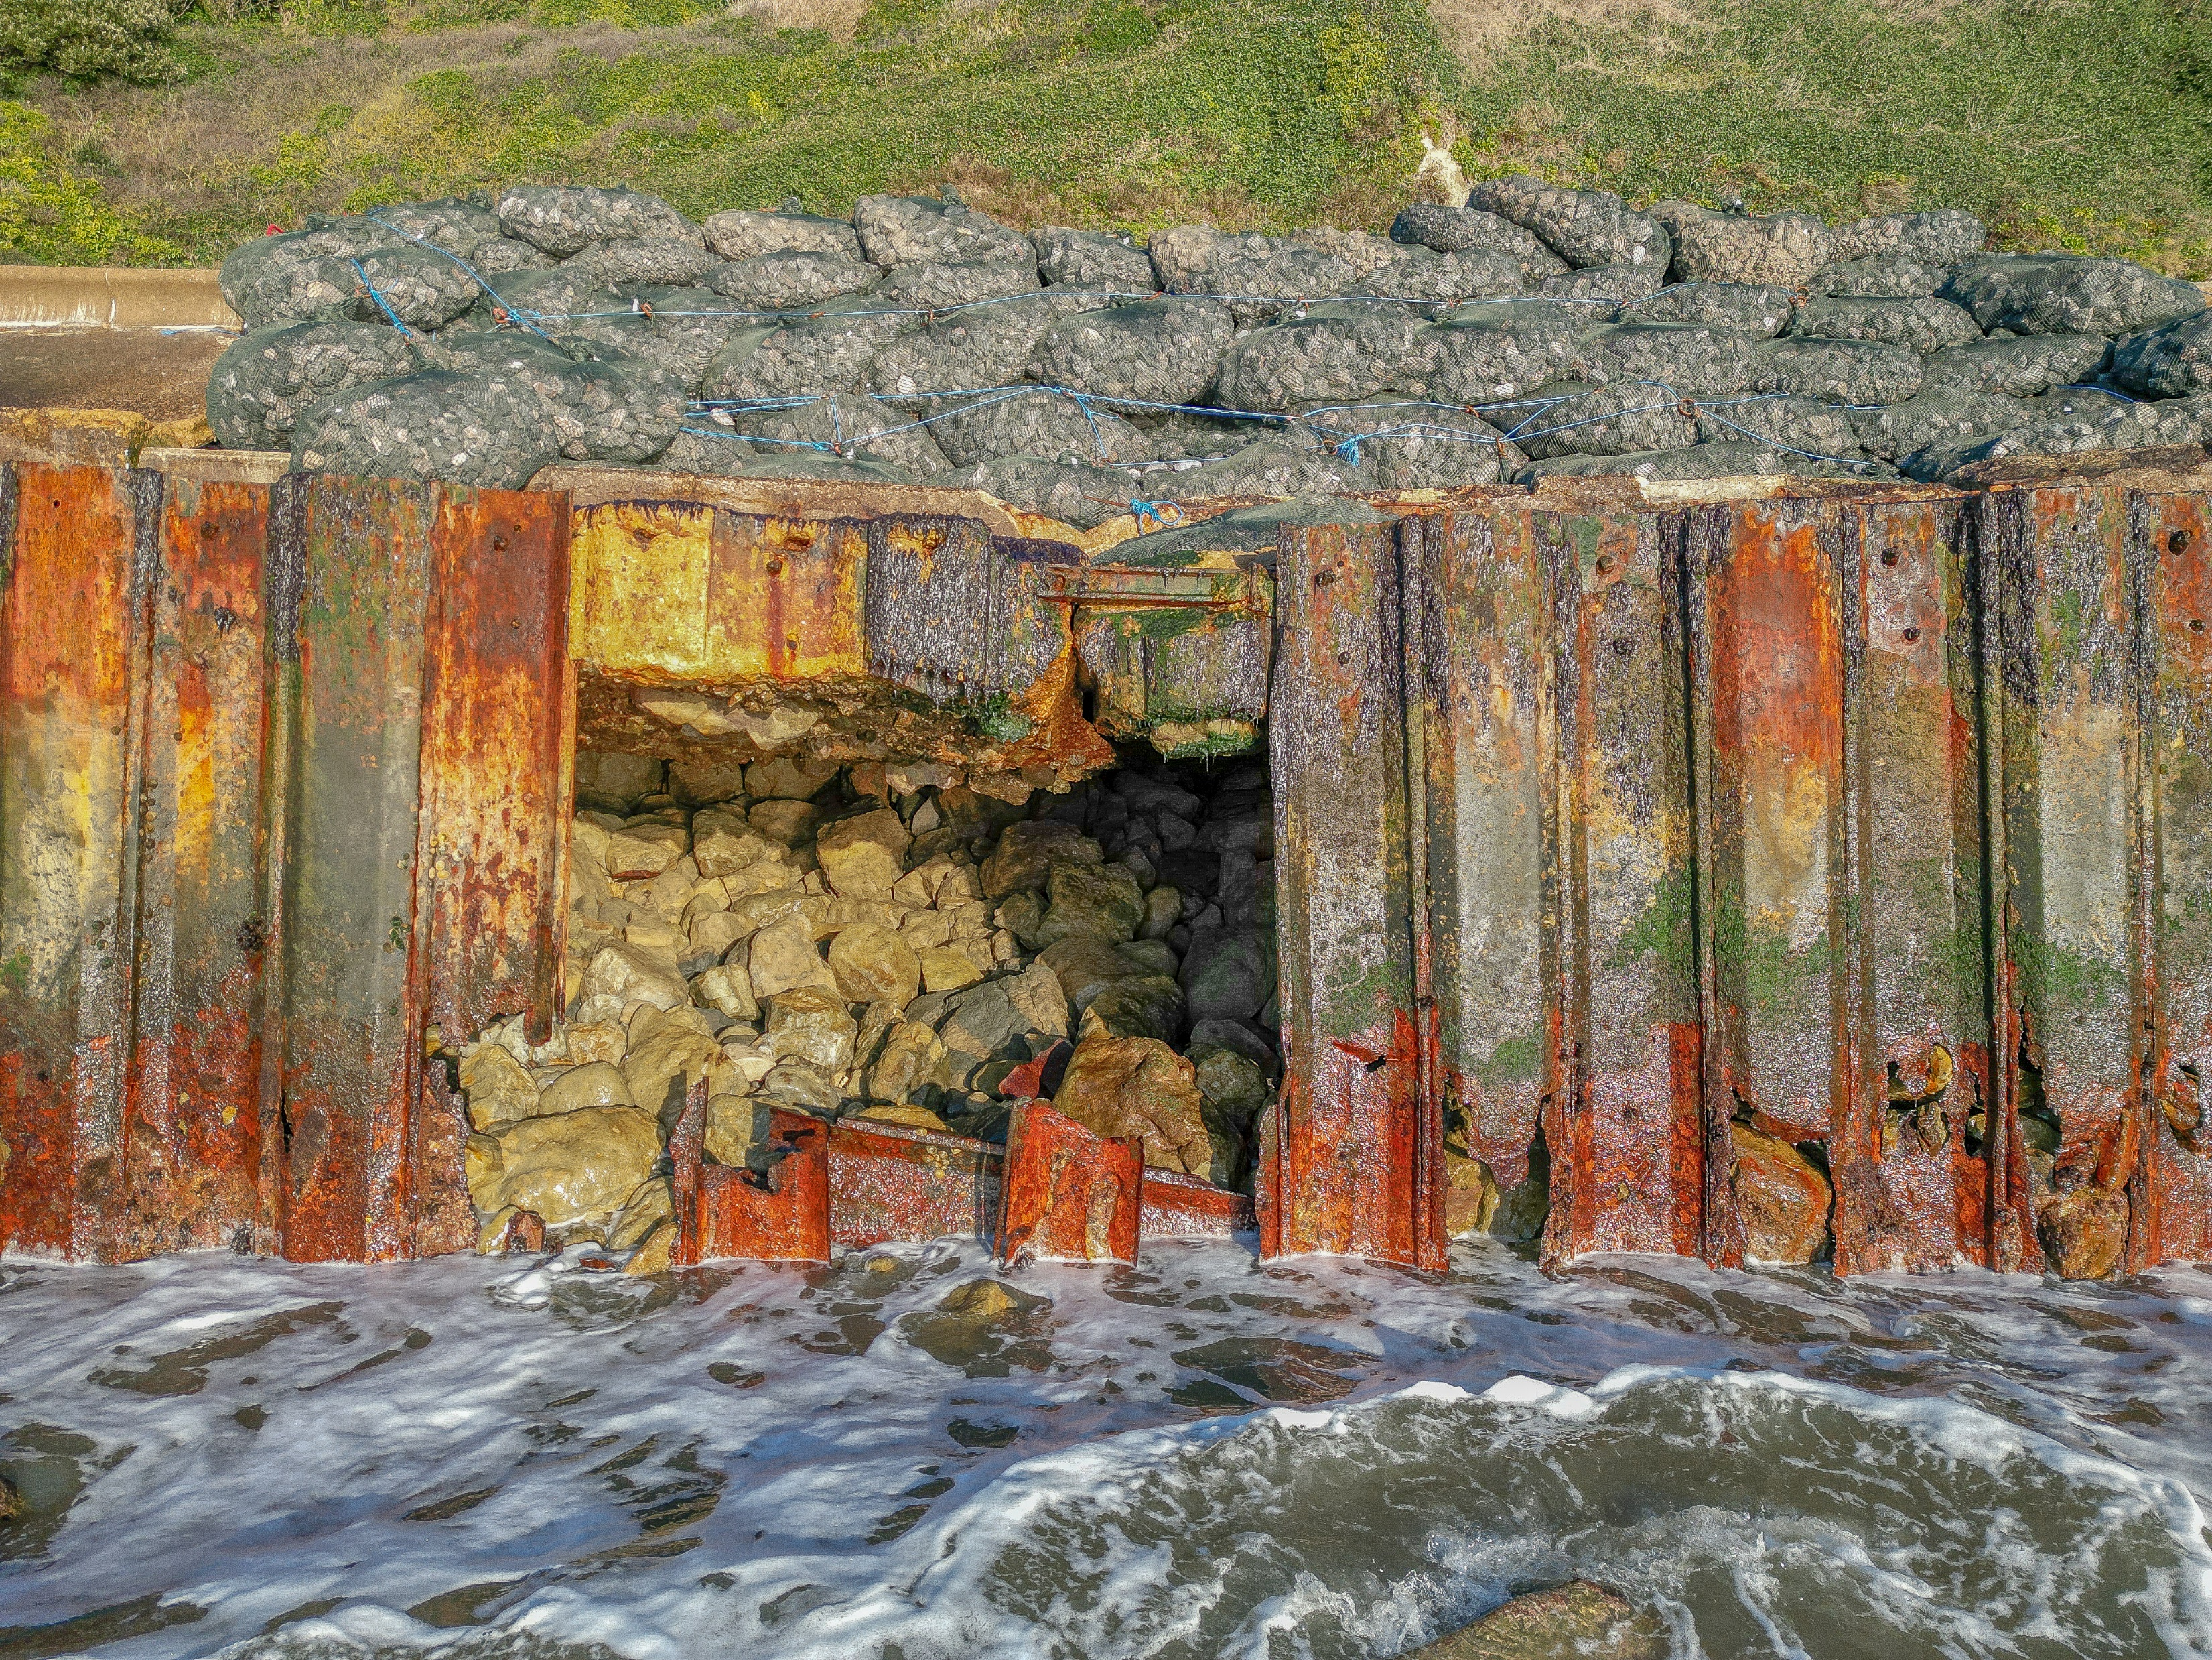
Emergency Works – decaying infrastructure

Slide 12
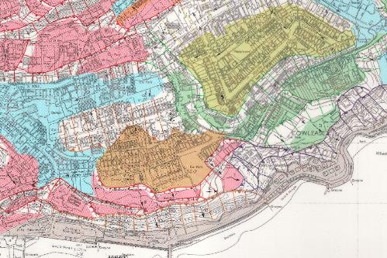



Emergency Repairs (GIA funding available with business case)
Urgent Works – funding to be brought forward from major capital schemes (IWC Project Managing)
Capital Works (EA& IWC Partnership programme of works 5 years away)
Closure
Seawall Failure
Closure
Environmental risk from southern water sewar pipe cracking releasing raw sewage
Prevent further damage to defence structures
Properties within the landslide complex
Economic losses to the beachfront

Slide 13
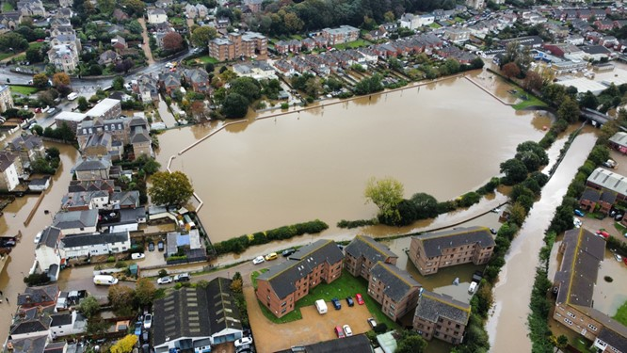
2023 Oct/November Flooding
261 properties and businesses flooded
Section 19 investigations
Multi-agency working
Community capacity building essential
Review of Flood Management Strategy and Investment

Slide 14
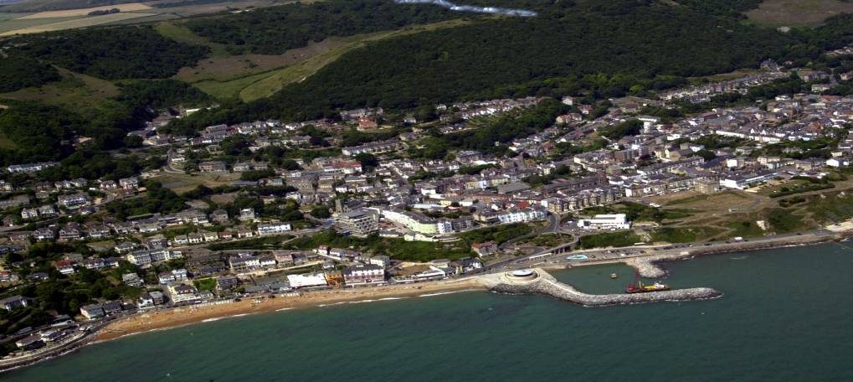
Dec 2023 – Major Landslide in Bonchurch
ancient deep-seated landslide complex extending some 2km offshore from the Last Glacial Period, 11,700 years ago
Apparent stability of Undercliff allowed occupation and development
Rapid urban development took place in Victorian period (early to mid 1800s)
Population of Undercliff currently >6000

Slide 15
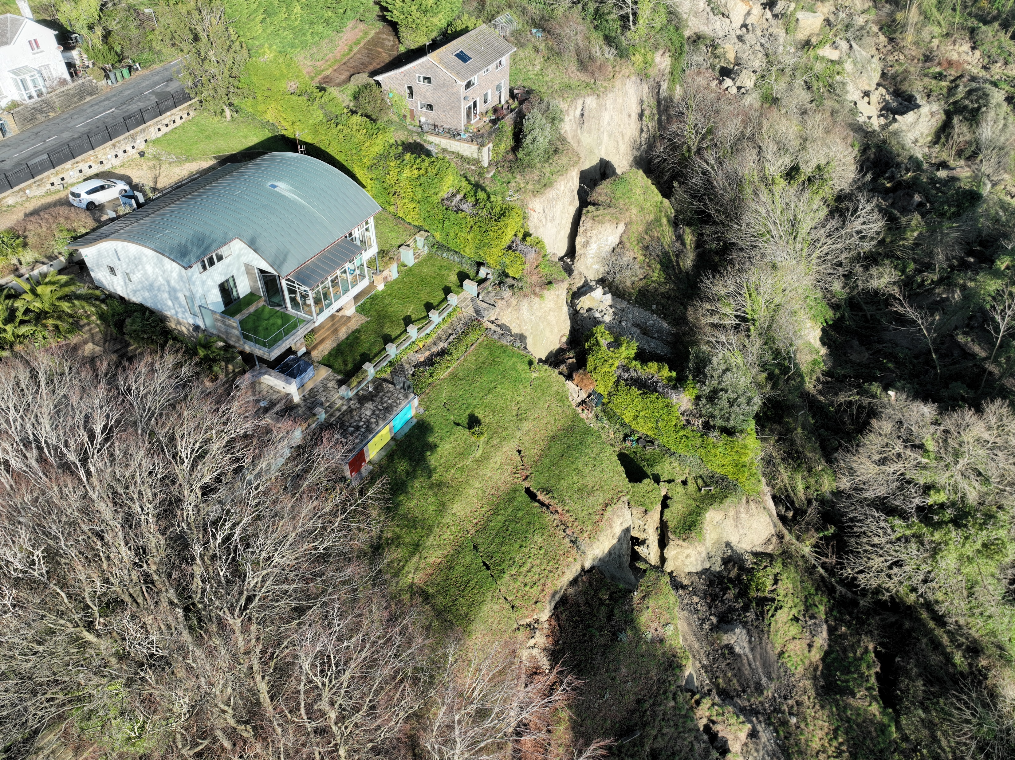
Dec 2023 – Major Landslide in Bonchurch
10pm landslide
20 properties evacuated in the night
Main a-road closed
Followed by further road closure at the Graben Lowtherville

Slide 16
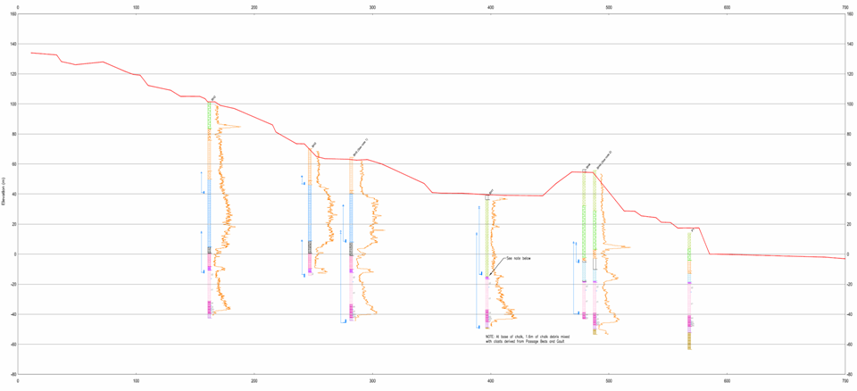
The undercliff landslide complex
B3327 Newport Road
St Alban’s Church
Lowtherville Graben
St Alban’s Road
St Alban’s
Steps
Castle Road
LOWER CHALK
Lower Gills
Cliff Road
Park Avenue
CHERT BEDS
Ventnor Park
MALM ROCK
72 m
60 m
Coastal Rock Revetment
PASSAGE BEDS
38 m
Western Cliffs
GAULT
CHALK
DEBRIS
18 m
Basal shear surface to base of Gault
2e
CARSTONE
2d
SANDROCK
2c
2b
2a
Movement recorded here
GEOLOGICAL SECTION
Scale 1:1000
FERRUGINOUS SAND
DEPTH UNKNOWN

Slide 17
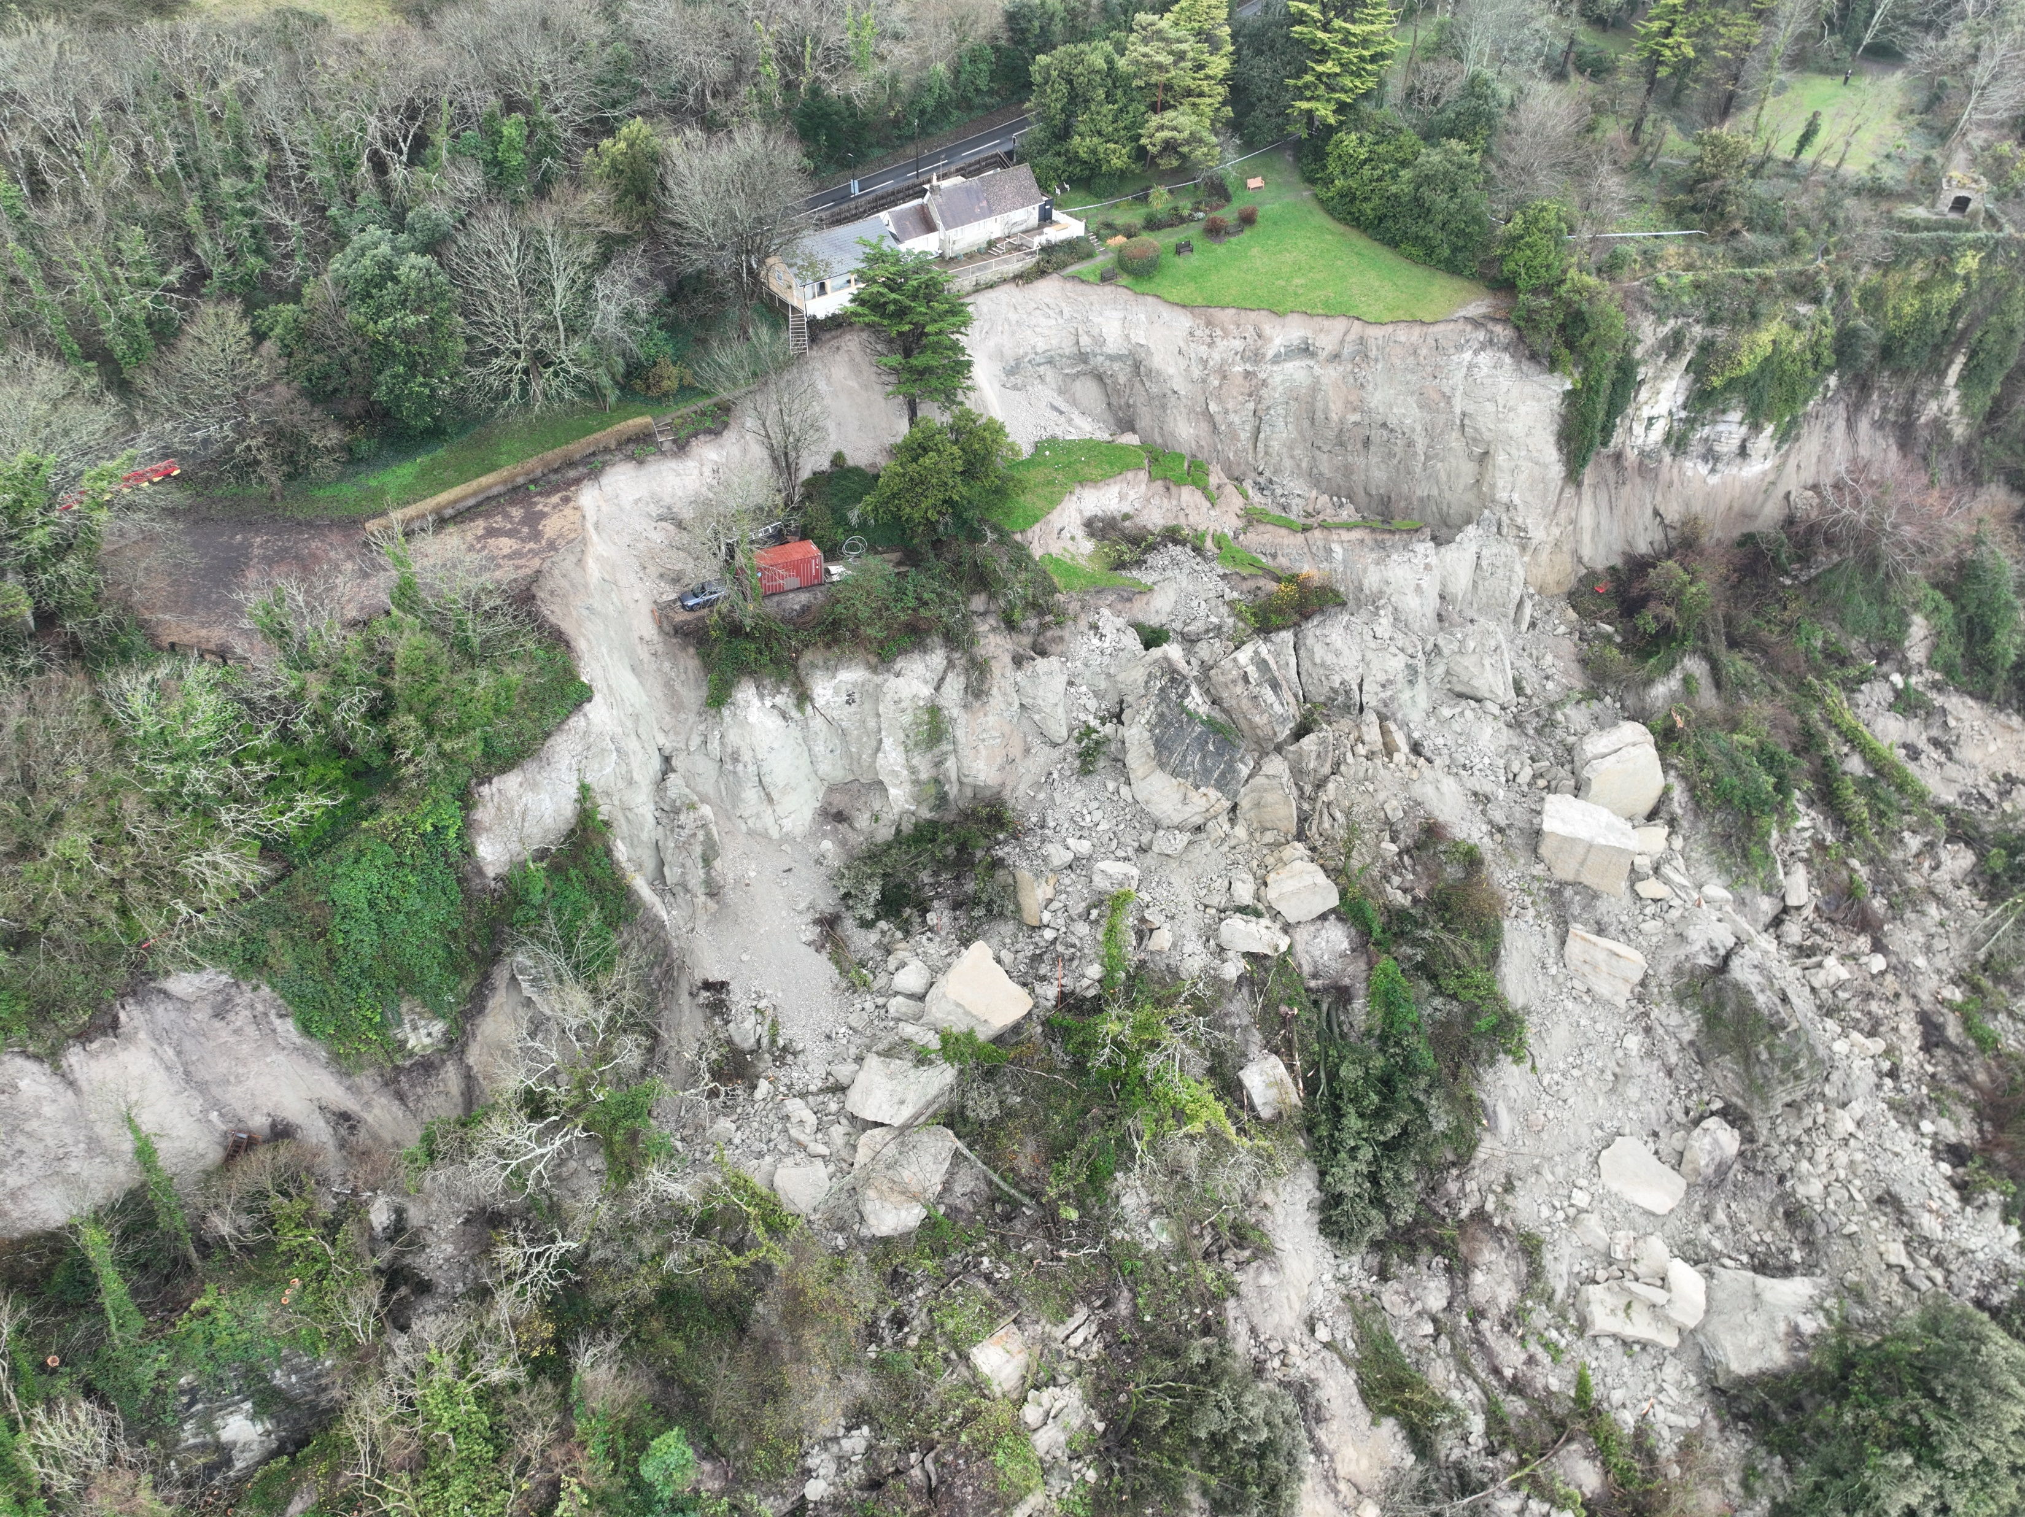
42 hectares of displaced land
14m cubic meters of material
One of the largest landslides recorded in the south coast of Britain
Dec 2023 – Major Landslide in Bonchurch

Slide 18
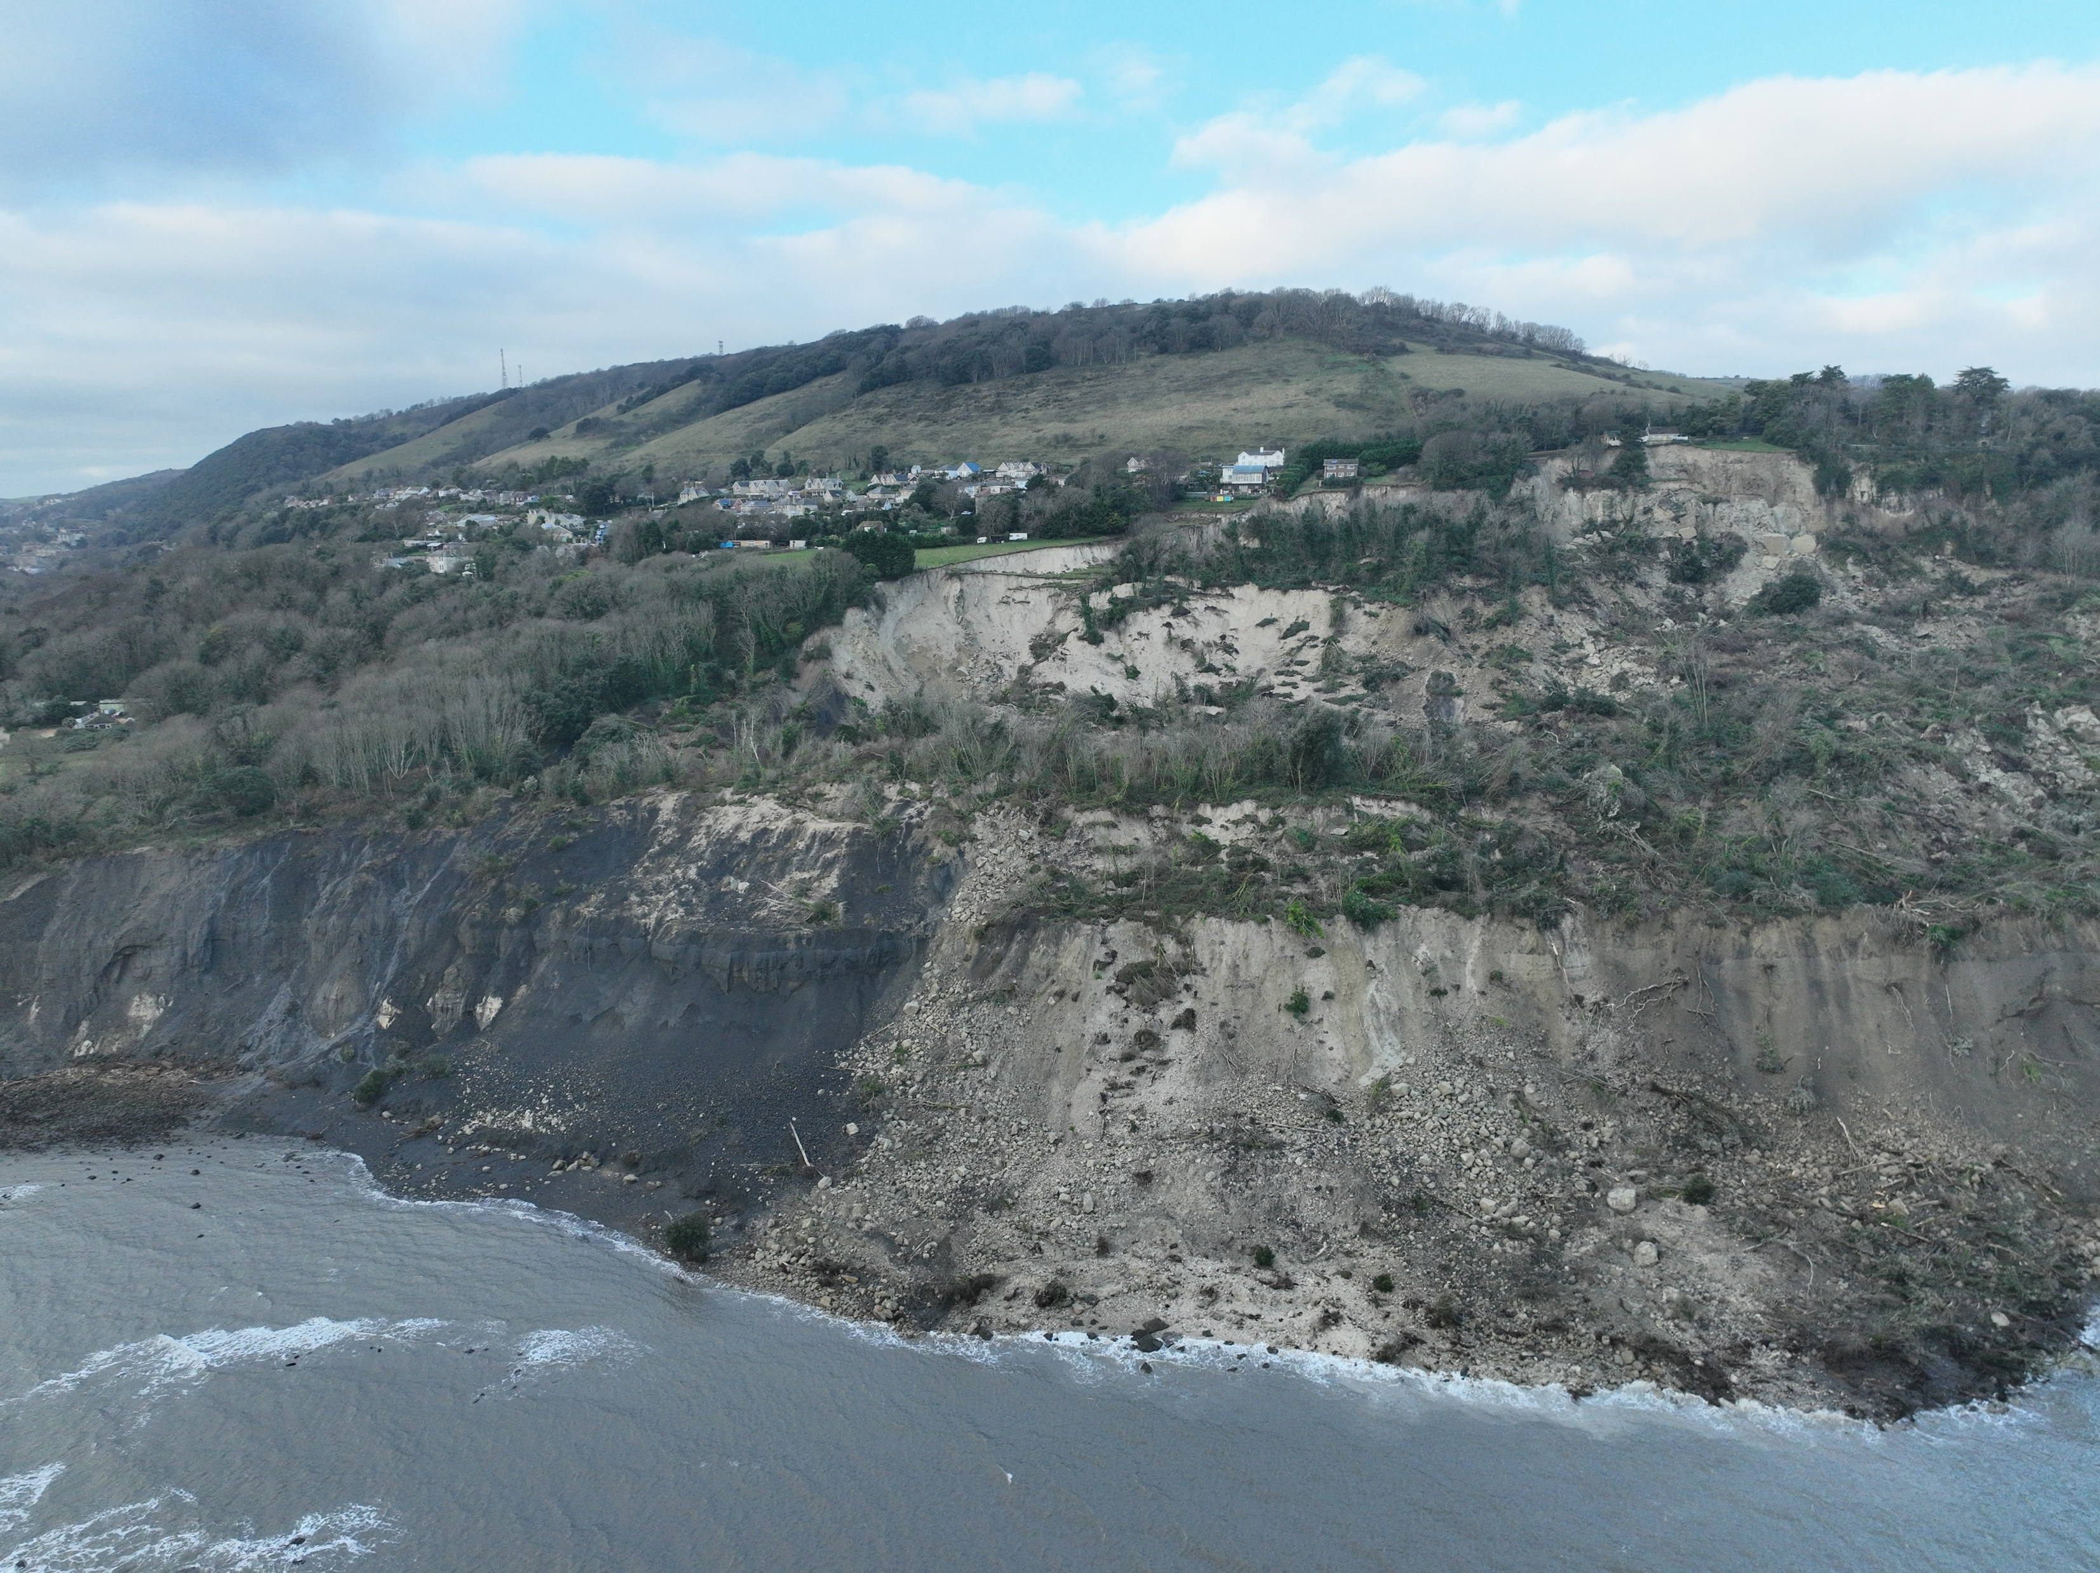
Dec 2023 – Major Landslide in Bonchurch

Slide 19


