Slide 1
Bucks Tree Mission 01/03/2023 The Big Energy Summit 2023
Alexander Beckett
Climate Change Programme & Partnership Manager
Buckinghamshire Council

Slide 2
Contents
Nature Based Solutions to Climate Change
Ecosystem Services
Policy Drivers
Tree Planting Considerations & Progress
‘22/’23 Projects and Beyond

Slide 3
1. Nature Based Solutions to Climate Change
Nature-based solutions (NbS) to climate change, sometimes called “natural climate solutions,” involve conserving, restoring, or better managing ecosystems to:
remove carbon dioxide (CO2) from the atmosphere
reduce emissions of greenhouse gases, and
assist with the adaptation to a changing climate
‘Research highlights that NbS could provide around 30% of the cost-effective mitigation needed by 2030 to stabilise warming to below 2°C. They can also provide a powerful defence against the impacts and long-term hazards of climate change, which is the biggest threat to biodiversity.’
International Union for the Conservation of Nature (IUCN), Global Standard for Nature-based Solutions
Notes:
The UK Government has established ambitious plans to increase woodland cover in the England Tree Action Plan. The per annum target is set in part to help achieve the UK’s net zero carbon emissions by 2050 target.
The Council made its commitment to plant 543,000 trees on Council land on 16th February 2021. Woodland Carbon Units generated against this commitment will help offset the Council’s residual carbon emissions – those emissions that can’t be mitigated by other means.
In recognising the shared responsibility to address climate change and other environmental challenges (such as poor air quality and flooding), the Bucks Tree Mission was launched later on in 2021.
The Right Place for the Right Trees means increasing tree cover whilst protecting what is special and valued in the landscape and keeping the environmental benefits already being delivered. Consideration has to be made of physical, environmental, legal, historic, and stakeholder aspects regarding the planting of trees.
In the assessment of sites for tree planting, some have been deemed not viable due to the presence of rare and important habitats, such as chalk grassland, or the establishment of new woodland would have a negative visual impacts on conservation areas. On other sites areas have to be excluded from planting due to the presence of: buried utility services or archaeological features (such as ridge and furrow earthworks); or to provide sufficient room for maintenance activity to occur (such as thinning – which is the removal of individual trees in order to benefit total woodland development). The UK Forestry Standard requires 10% minimum open space to be present in new woodland.
Selecting the right species and size of tree for sites takes into account the purpose for establishing new trees, for example 12-14cm girth trees are required for trees established next to the public highway; climatic conditions, and soil type and suitability (planting trees on clay capped landfill sites is undesirable), and the proximity of natural water features.
Establishment has to take into account: biosecurity aspects – making sure that disease carrying agents are prevented from migrating as far as practicable, and keeping sites secure, safe, and presentable - which requires the installation of controlled access features such as fencing and gates, and signage. Maintenance agreements typically cover litter picking, mowing of open areas, replacing dead trees (known as beating up), weed clearance, and repairs. The most important time to care for young trees is within the first five years – regular watering is critical to support its health and growth.
There may be specific covenants regarding the use of land that affect the ability to plant trees, or agreements that mean that acquiring management control rights to establish new woodland has to consider tenancy renewal cycles, and existing commitments related to agricultural subsidies and the use of the land – where crops are planted it’s best to take management control of the site after harvest (typically in September).

Slide 4
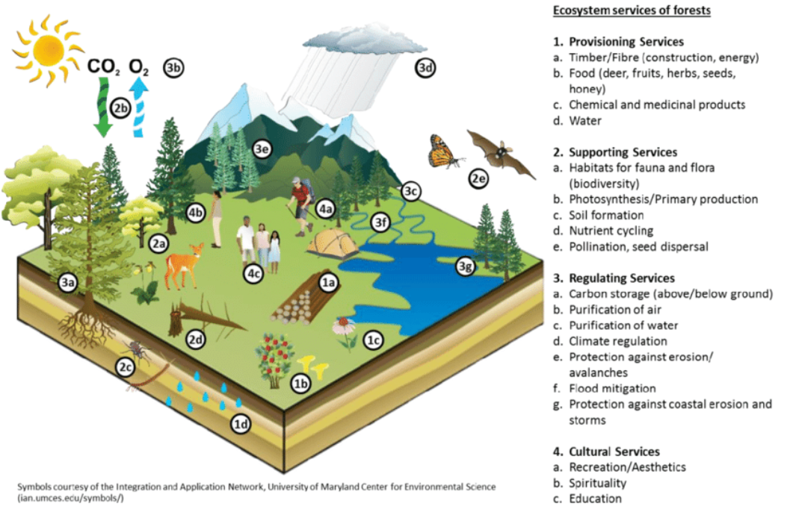
2. Ecosystem Services
Trees provide a diverse range of ecosystem services
Notes:
It’s widely acknowledged that trees provide a wide range of ecosystem services, from regulating the climate – where shade from trees can help reduce building cooling costs – to improving water quality, providing materials for construction, and increasing biodiversity.

Slide 5
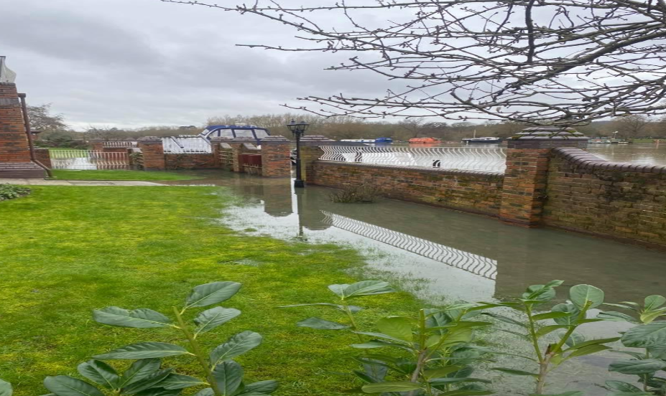
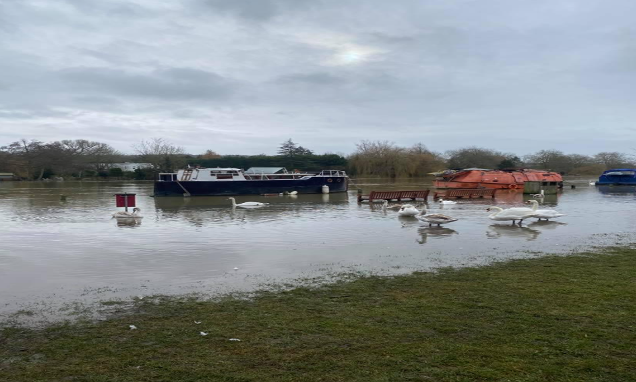
2. Ecosystem Services
Defra, Enabling a Natural Capital Approach (2020)
Regulating services
flood regulation
£89 per ha woodland (avoided flood water storage costs)
£221 per ha woodland in flood plain
£250 per ha avoided flood damage
temperature regulation – temperature reduction of:
3.5˚C by urban woodland
0.95˚C by urban parks
2-8˚C trees and green infrastructure
0.69-0.88˚C aggregated cooling effect of green and blue spaces in London/Manchester/Edinburgh/West of England
£0.05 per hour per tree (2017 prices; London)
Pics: Marlow Floods in Feb 2021
Source: Bucks Free Press

Slide 6
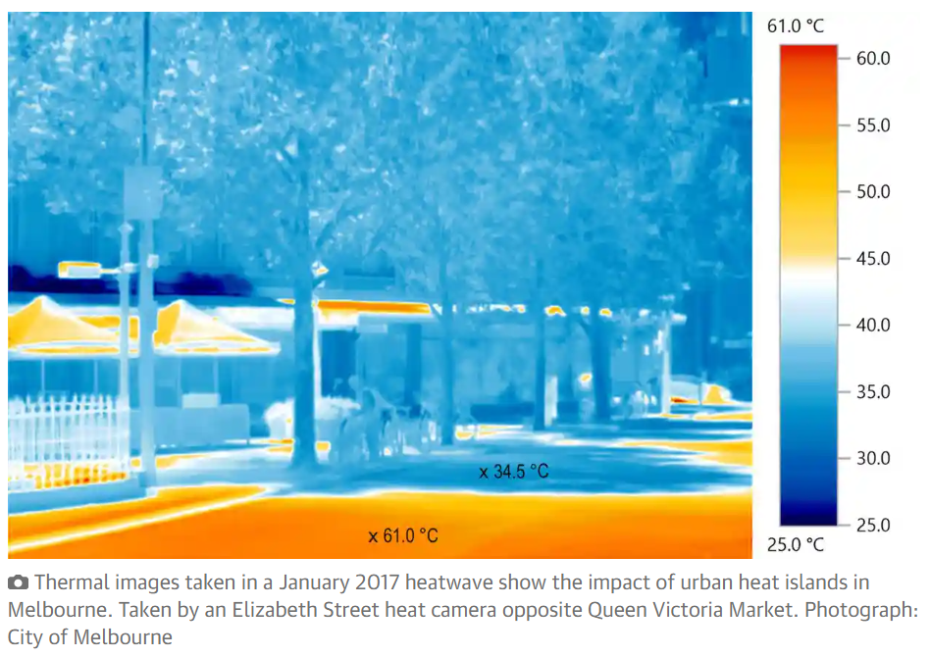
2. Ecosystem Services
Source: The Guardian

Slide 7
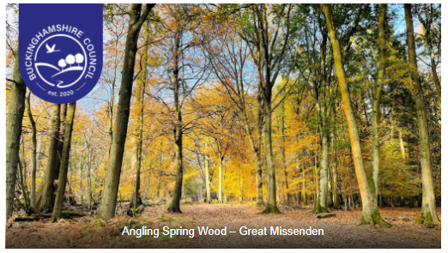
2. Ecosystem Services
Cultural services
Recreation – per visit
£3.10 - £3.96 woodland
£1.60 - 3.06 average for outdoor/greenspace sites
Physical health – per visit
£3.07
Education – per pupil per visit
£21.03 nature based trip
£2.08 - £6.90 nature reserves
Volunteering – per volunteer hour
£13.09

Slide 8
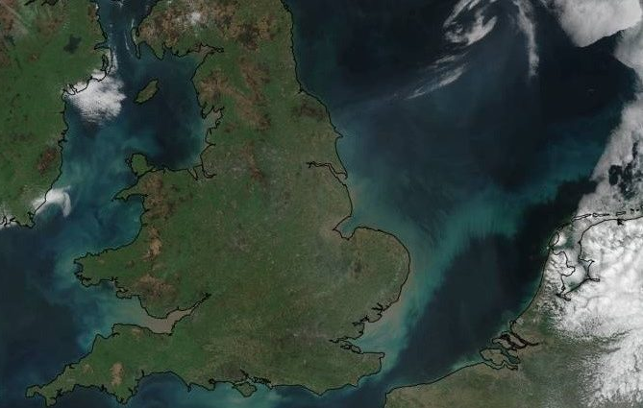
2. Ecosystem Services
Supporting Services
Local environmental amenity – house price increase
0.6 – 2.2% within 500m of public green space
1.1 – 2.8% within 100m “
2% for houses with a view over green or blue space
- quality of life (view) per person per year
£135 – £452 views of green space from home
£171 - £575 for use of own garden
Combating soil erosion –
Average rate of erosion 0.21t per ha p.a. (2.92 mill tonnes p.a. in England and Wales)
£30-50 mill. agricultural production loss
£50-80 mill. increased flood risk
£25-40 mill. water quality loss
Source: Suffolk Farm Wildlife Advisory Group

Slide 9
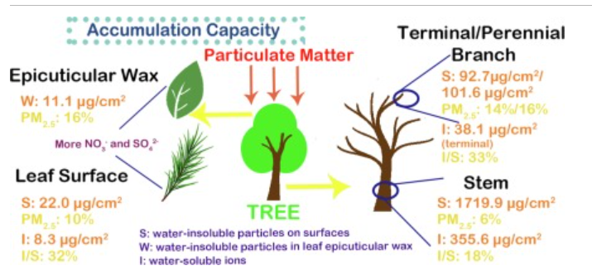
2. Ecosystem Services
Defra, Enabling a Natural Capital Approach (2020)
Provisioning services – timber - £21.49 per m3 overbark (2016 prices) (based on Forestry Statistics Timber Price Indices)
Regulating services
air pollutant removal
£771 per ha urban woodland
£245 per ha rural woodland
carbon sequestration (assumes average of £24 per tonne CO2 sequestered)
5.69t per ha woodland (average) = £136.56 per ha
Source: ScienceDIrect.com

Slide 10
2. Ecosystem Services
Backed by the UK Government
For UK Forestry Standard compliant 5ha woodland creation projects where there is the desire to generate verified woodland carbon units (and used for offset purposes: 1 WCU = 1 tonne of CO2 sequestered)
Projects must be registered to the Land Carbon Registry (currently operated by IHS Markit Register)
An accredited body needs to validate the project within three years
Ongoing verification needs to happen by an accredited body up to 100 years (from year 5 then every 10 years)
Pending Issuance Units (‘the promise of carbon sequestered’) are issued initially at 3p per unit and then converted to Woodland Carbon Units at each verification milestone
WCUs currently being traded at £24 per WCU

Slide 11
3. Policy Drivers
Events in 2021 provide the major foundation for progressing tree planting:
Buckinghamshire Council commits to planting 543,000 trees on Council land by 2032 (16th Feb)
England Trees Action Plan 2021-2024 is published setting out a target of 30,000ha woodland being planted per annum (May)
Buckinghamshire Council:
adopts a Climate Change and Air Quality Strategy (19th Oct)
launches the Bucks’ Tree Mission during National Tree Week (29th Nov) - a shared mission encouraging everyone to plant trees for a greener future.
2022 delivered the Environment Act, with targets to:
Halt species population decline by 2030, and then increase populations by at least 10% to exceed current levels by 2042
Restore precious water bodies to their natural state
Deliver our net zero ambitions and boost nature recovery by increasing tree and woodland cover to 16.5% of total land area in England by 2050
Cut exposure to the most harmful air pollutant to human health – PM2.5
Restore 70% of designated features in our Marine Protected Areas to a favourable condition by 2042, with the rest in a recovering condition.
Notes:
The UK Government has established ambitious plans to increase woodland cover in the England Tree Action Plan. The per annum target is set in part to help achieve the UK’s net zero carbon emissions by 2050 target.
The Council made its commitment to plant 543,000 trees on Council land on 16th February 2021. Woodland Carbon Units generated against this commitment will help offset the Council’s residual carbon emissions – those emissions that can’t be mitigated by other means.
In recognising the shared responsibility to address climate change and other environmental challenges (such as poor air quality and flooding), the Bucks Tree Mission was launched later on in 2021.
The Right Place for the Right Trees means increasing tree cover whilst protecting what is special and valued in the landscape and keeping the environmental benefits already being delivered. Consideration has to be made of physical, environmental, legal, historic, and stakeholder aspects regarding the planting of trees.
In the assessment of sites for tree planting, some have been deemed not viable due to the presence of rare and important habitats, such as chalk grassland, or the establishment of new woodland would have a negative visual impacts on conservation areas. On other sites areas have to be excluded from planting due to the presence of: buried utility services or archaeological features (such as ridge and furrow earthworks); or to provide sufficient room for maintenance activity to occur (such as thinning – which is the removal of individual trees in order to benefit total woodland development). The UK Forestry Standard requires 10% minimum open space to be present in new woodland.
Selecting the right species and size of tree for sites takes into account the purpose for establishing new trees, for example 12-14cm girth trees are required for trees established next to the public highway; climatic conditions, and soil type and suitability (planting trees on clay capped landfill sites is undesirable), and the proximity of natural water features.
Establishment has to take into account: biosecurity aspects – making sure that disease carrying agents are prevented from migrating as far as practicable, and keeping sites secure, safe, and presentable - which requires the installation of controlled access features such as fencing and gates, and signage. Maintenance agreements typically cover litter picking, mowing of open areas, replacing dead trees (known as beating up), weed clearance, and repairs. The most important time to care for young trees is within the first five years – regular watering is critical to support its health and growth.
There may be specific covenants regarding the use of land that affect the ability to plant trees, or agreements that mean that acquiring management control rights to establish new woodland has to consider tenancy renewal cycles, and existing commitments related to agricultural subsidies and the use of the land – where crops are planted it’s best to take management control of the site after harvest (typically in September).

Slide 12
3. Policy Drivers – Climate Change & Air Quality Strategy
The Council’s Emissions to Air
13. Implement a large scale tree planting programme across the estate.
14. Explore the potential for blue and green infrastructure improvement projects (e.g. green roofs) across our estate.
21. Enhance and support sustainable tree management practices.
Suppliers and Partners
27. Help communities identify, develop, and secure funding for projects addressing climate change and/or air quality.
County-wide
53. Promote opportunities for residents to improve their homes to help them mitigate and/or adapt to climate change and poor air quality.
55. Support the development of the green economy in Buckinghamshire.
57. Work with the Environment Agency and other partners to minimise the risk of flooding and improve community flood resilience.
60. Encourage environmentally sustainable living via communications campaigns.
Control

Slide 13
4. Tree Planting Considerations & Progress
Site considerations
1. Soil type and suitability
2. Proximity of natural water features
3. Biodiversity and ecology of the area proposed for planting (e.g. chalk grassland?; local tree species)
4. Landscape
5. Historic environment (e.g. statutory designations)
6. Presence of utility services
7. Climate (e.g. rainfall, wind)
8. Protection against weeds and pests (e.g. mulch matts, and rabbit netting)
9. Stakeholder access
10. Maintenance, security, and safety
11. Property ownership, rights and covenants
12. Biosecurity
13. Purpose (e.g. for fruit; roadside tree)
14. Conformance (e.g. UK Forestry Standard)
15. Cost
Notes:
The UK Government has established ambitious plans to increase woodland cover in the England Tree Action Plan. The per annum target is set in part to help achieve the UK’s net zero carbon emissions by 2050 target.
The Council made its commitment to plant 543,000 trees on Council land on 16th February 2021. Woodland Carbon Units generated against this commitment will help offset the Council’s residual carbon emissions – those emissions that can’t be mitigated by other means.
In recognising the shared responsibility to address climate change and other environmental challenges (such as poor air quality and flooding), the Bucks Tree Mission was launched later on in 2021.
The Right Place for the Right Trees means increasing tree cover whilst protecting what is special and valued in the landscape and keeping the environmental benefits already being delivered. Consideration has to be made of physical, environmental, legal, historic, and stakeholder aspects regarding the planting of trees.
In the assessment of sites for tree planting, some have been deemed not viable due to the presence of rare and important habitats, such as chalk grassland, or the establishment of new woodland would have a negative visual impacts on conservation areas. On other sites areas have to be excluded from planting due to the presence of: buried utility services or archaeological features (such as ridge and furrow earthworks); or to provide sufficient room for maintenance activity to occur (such as thinning – which is the removal of individual trees in order to benefit total woodland development). The UK Forestry Standard requires 10% minimum open space to be present in new woodland.
Selecting the right species and size of tree for sites takes into account the purpose for establishing new trees, for example 12-14cm girth trees are required for trees established next to the public highway; climatic conditions, and soil type and suitability (planting trees on clay capped landfill sites is undesirable), and the proximity of natural water features.
Establishment has to take into account: biosecurity aspects – making sure that disease carrying agents are prevented from migrating as far as practicable, and keeping sites secure, safe, and presentable - which requires the installation of controlled access features such as fencing and gates, and signage. Maintenance agreements typically cover litter picking, mowing of open areas, replacing dead trees (known as beating up), weed clearance, and repairs. The most important time to care for young trees is within the first five years – regular watering is critical to support its health and growth.
There may be specific covenants regarding the use of land that affect the ability to plant trees, or agreements that mean that acquiring management control rights to establish new woodland has to consider tenancy renewal cycles, and existing commitments related to agricultural subsidies and the use of the land – where crops are planted it’s best to take management control of the site after harvest (typically in September).

Slide 14
4. Tree Planting Considerations & Progress
Multiple stakeholders undertaking planting and maintenance
£3.29m (of £5m internal Climate Change Fund) dedicated to achieving the tree planting target.
Buckinghamshire
Council land
Major private landowners (e.g. farmers)
Parks and Countryside Service - internal
Property and Assets –
corporate estate
Parks and Countryside Service - outsourced
Property and Assets – investment estate
Private Schools / Academies
Schools
Property and Assets –
agricultural estate
Businesses
Climate Response
Highways
Other public sector organisations
Parish and Town Councils
Third sector organisations
Developers
Residents
Notes:
Individuals and organisations across Buckinghamshire are involved in tree planting or management activities.
While we are focused on planting 543,000 trees on Council land, we are supportive of the contributions being made to improve the number and health of trees in Buckinghamshire. As such there is a project underway to map trees planted as a result of Council activity….

Slide 15
4. Tree Planting Considerations & Progress
Queens Green Canopy (‘21/’22)
Offered a free tree to care homes and schools in Buckinghamshire
Interested parties received trees from the Woodland Trust and plaques
Funded from a special projects reserve
Buckinghamshire
Council land
Queens Green Canopy
Major private landowners (e.g. farmers)
Parks and Countryside Service - internal
Property and Assets –
corporate estate - care homes
Parks and Countryside Service - outsourced
Property and Assets – investment estate
Private Schools / Academies
Schools
Property and Assets –
agricultural estate
Businesses - care homes
Climate Response
Highways
Other public sector organisations
Parish and Town Councils
Third sector organisations - - care homes
Developers
Residents
Notes:
In support of the Queens Green Canopy we offered a free tree to care homes and schools in Buckinghamshire for planting in the ‘21/’22 planting season.

Slide 16
4. Tree Planting Considerations & Progress
Parks and Countryside
Ongoing activity to maintain treescapes in Council parks and PROWs
Volunteer tree planting undertaken by Council staff ‘21/’22 with Chiltern Rangers
Buckinghamshire
Council land
Treescape maintenance
Major private landowners (e.g. farmers)
Parks and Countryside Service - internal
Property and Assets –
corporate estate
Parks and Countryside Service - outsourced
Property and Assets – investment estate
Private Schools / Academies
Schools
Property and Assets –
agricultural estate
Businesses
Climate Response
Highways
Other public sector organisations
Council Staff Volunteer Tree Planting
Parish and Town Councils
Third sector organisations
Developers
Residents
Notes:
Council staff have participated in several volunteer tree planting days which have been run with Chiltern Rangers.
As part of ongoing service delivery the Parks and Countryside Service actively manages trees in Council Parks and along Public Rights of Way. This includes the planting of new trees.

Slide 17
4. Tree Planting Considerations & Progress
Internal Tree Replacement Fund
£138k to replace 158 trees removed from the public highway
Buckinghamshire
Council land
Int. Tree Replacement Fund
Major private landowners (e.g. farmers)
Parks and Countryside Service - internal
Property and Assets –
corporate estate
Parks and Countryside Service - outsourced
Property and Assets – investment estate
Private Schools / Academies
Schools
Property and Assets –
agricultural estate
Businesses
Climate Response
Highways
Other public sector organisations
Parish and Town Councils
Third sector organisations
Developers
Residents

Slide 18
4. Tree Planting Considerations & Progress
Local Authority Treescapes Fund
Secured £203k in ‘21/’22 and £184k in ‘22/’23 to support tree planting (in stands of ≤0.5ha) and maintenance (3 yrs) in non-woodland locations
Upper tier local authority led with a primary focus on community projects
Buckinghamshire
Council land
Major private landowners (e.g. farmers)
Parks and Countryside Service - internal
Property and Assets –
corporate estate
Parks and Countryside Service - outsourced
Property and Assets – investment estate
Private Schools / Academies
Schools
Property and Assets –
agricultural estate
Businesses
Climate Response
Highways
Other public sector organisations
Local Authority Treescapes Fund
Parish and Town Councils
Third sector organisations
Developers
Residents
Notes:
Our bid in 2021 to the Local Authority Treescapes Fund resulted in successfully securing funding to benefit projects led by 3 charities, 2 parish councils and Transport for Buckinghamshire.

Slide 19
4. Tree Planting Considerations & Progress
England Woodland Creation Offer
Open to all landowners and has 1 ha minimum size requirement
Funding cap for standard costs increased from £8,500 to £10,200 per ha in ‘22
Secured £28k in ‘21/’22 to for tree planting and maintenance at Billet Field;
and £105k and £110k in ‘22/’23 for Bury Farm and Grange Farm respectively
Buckinghamshire
Council land
England Woodland Creation Offer
Major private landowners (e.g. farmers)
Parks and Countryside Service - internal
Property and Assets –
corporate estate
Parks and Countryside Service - outsourced
Property and Assets – investment estate
Private Schools / Academies
Schools
Property and Assets –
agricultural estate
Businesses
Climate Response
Highways
Other public sector organisations
Parish and Town Councils
Third sector organisations
Developers
Residents
Notes:
In 2021 we also successfully bid for funding from the England Woodland Creation Offer. This included elements related nature recovery and mitigating flood risk.
EWCO Element Value
Standard Costs - £14,620.00
Nature Recovery Higher - £4,816.00
Flood Risk - £860.00
Close to Settlements - £860.00
Recreational Access - £3,784.00
10 years’ worth of maintenance - £3,440.00
Total - £28,380.00

Slide 20
4. Tree Planting Considerations & Progress
England Woodland Creation Offer grant applications (for sites of 1ha) provide:
£10,200 per ha ‘one-off’ contribution
£350 per ha per annum contribution for maintenance (10 years max.)
Additional ‘one-off’ grant contributions will be sought where sites:
Are close to settlements (£500 per ha)
Provide nature recovery benefits – e.g. woodland expansion (£1,100 / £2,800 per ha)
Provide water quality benefits – e.g. reduce pollution to watercourses (£400 per ha)
Mitigate flood risk (£500 per ha)
Provide shading / wildlife corridors for watercourses (£1,600 per ha)
£2,200 per ha for recreational access

Slide 21
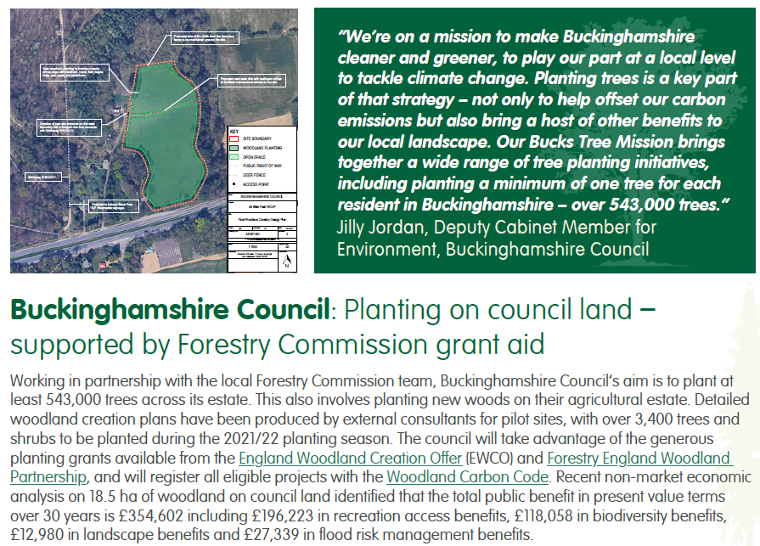
4. Tree Planting Considerations & Progress
Inclusion in a Forestry Commission case study published in January – ‘Helping local authorities respond to the climate emergency’
Notes:
The Council’s efforts to establish new trees were recognised in a case study published by the Forestry Commission on 18th January 2022.

Slide 22
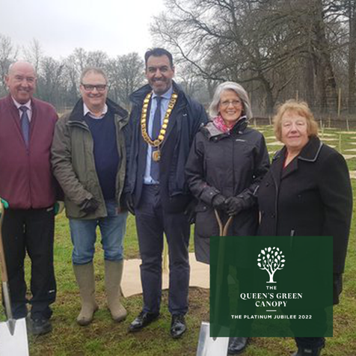
4. Tree Planting Considerations & Progress
Billet Field 3450
Local Authority Treescape Fund (LATF) 586
Queens Green Canopy (QGC) 168
Parks and Countryside 1656
Target: 543,000. ‘21/’22 Total: 5860
Notes:
Pryor and Rickett Silviculture was the contractor chosen in 2021 to plant and maintain the trees at Billet Field. Their maintenance obligations include clearing weeds around the trees (without using chemical weedkillers), inspecting and affecting minor repairs to fencing and gates, replacing dead trees, and mowing the grass along the rides (walking routes) in the woodland, and remove litter from the site. Discussions are underway regarding the long term maintenance of contractor planted sites beyond the initial 10 year term.
A community tree planting day was organised (following one failed attempt due to Storm Eunice) so that the public could be involved in the project.
In these pictures we can see the Pedunculate Oak, Cherry, Lime, Hornbeam, Sessile Oak, Scots Pine, Silver Birch, Crab apple, Field maple, Hawthorn, Dogwood, Hazel and Holly whips planted and protected by 100% biodegradable spiral guards and mulch matts.
10% of the trees planted in the last planting season were funded by the Local Authority Treescapes Fund.

Slide 23
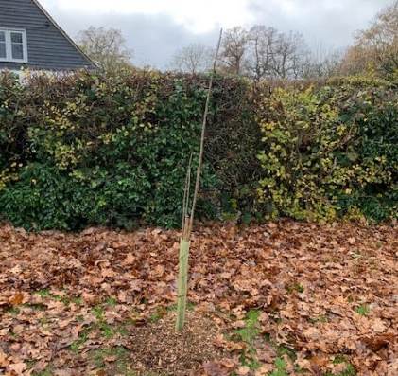
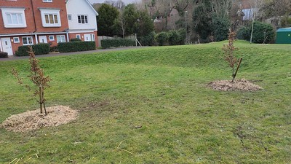
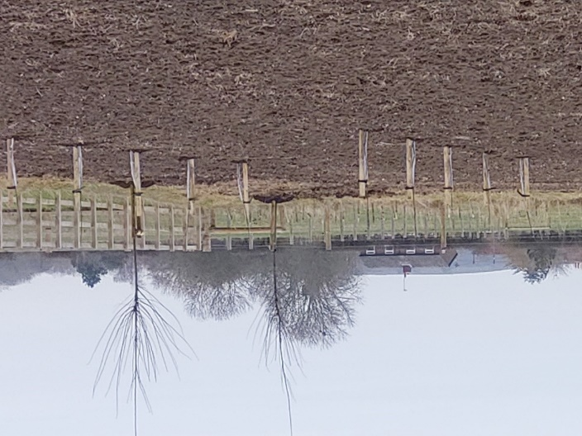
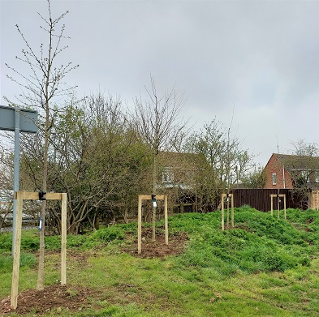
4. Tree Planting Considerations & Progress
New Trees
Council Land 5860
Non Council Land 469
Total 6329
Marlow community trees
Fruit Trees at the
Lady Ryder Memorial Garden,
Parmoor
Wye Dene housing development
Trees, High Wycombe
Trees for Buckland
Parish Council’s public
Green space
Haddenham community trees

Slide 24
4. Tree Planting Considerations & Progress
Council Land Tree Planting Programme Targets
Notes:
The UK Government has established ambitious plans to increase woodland cover in the England Tree Action Plan. The per annum target is set in part to help achieve the UK’s net zero carbon emissions by 2050 target.
The Council made its commitment to plant 543,000 trees on Council land on 16th February 2021. Woodland Carbon Units generated against this commitment will help offset the Council’s residual carbon emissions – those emissions that can’t be mitigated by other means.
In recognising the shared responsibility to address climate change and other environmental challenges (such as poor air quality and flooding), the Bucks Tree Mission was launched later on in 2021.
The Right Place for the Right Trees means increasing tree cover whilst protecting what is special and valued in the landscape and keeping the environmental benefits already being delivered. Consideration has to be made of physical, environmental, legal, historic, and stakeholder aspects regarding the planting of trees.
In the assessment of sites for tree planting, some have been deemed not viable due to the presence of rare and important habitats, such as chalk grassland, or the establishment of new woodland would have a negative visual impacts on conservation areas. On other sites areas have to be excluded from planting due to the presence of: buried utility services or archaeological features (such as ridge and furrow earthworks); or to provide sufficient room for maintenance activity to occur (such as thinning – which is the removal of individual trees in order to benefit total woodland development). The UK Forestry Standard requires 10% minimum open space to be present in new woodland.
Selecting the right species and size of tree for sites takes into account the purpose for establishing new trees, for example 12-14cm girth trees are required for trees established next to the public highway; climatic conditions, and soil type and suitability (planting trees on clay capped landfill sites is undesirable), and the proximity of natural water features.
Establishment has to take into account: biosecurity aspects – making sure that disease carrying agents are prevented from migrating as far as practicable, and keeping sites secure, safe, and presentable - which requires the installation of controlled access features such as fencing and gates, and signage. Maintenance agreements typically cover litter picking, mowing of open areas, replacing dead trees (known as beating up), weed clearance, and repairs. The most important time to care for young trees is within the first five years – regular watering is critical to support its health and growth.
There may be specific covenants regarding the use of land that affect the ability to plant trees, or agreements that mean that acquiring management control rights to establish new woodland has to consider tenancy renewal cycles, and existing commitments related to agricultural subsidies and the use of the land – where crops are planted it’s best to take management control of the site after harvest (typically in September).

Slide 25
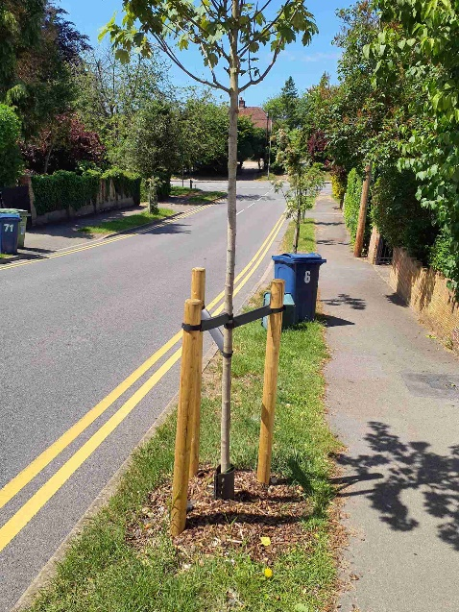
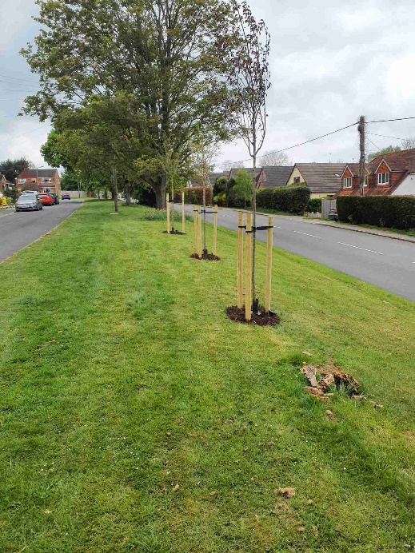
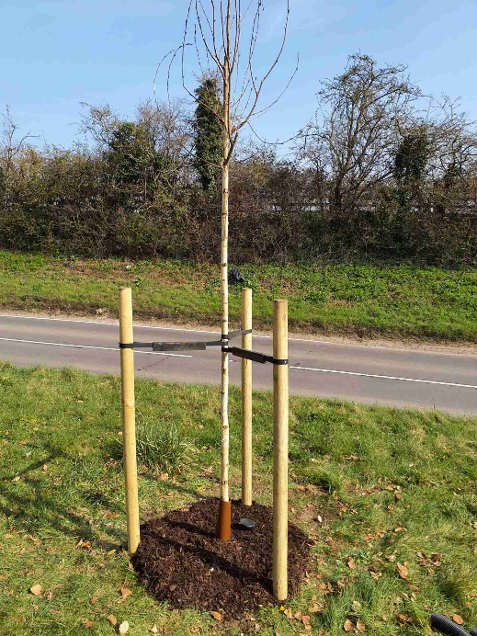
4. Tree Planting Considerations & Progress
Replacement Trees on the Public Highway
Aylesbury Vale Area 65
High Wycombe Area 47
Amersham Area 34
Total 146
Target: 158. Planted: 146

Slide 26
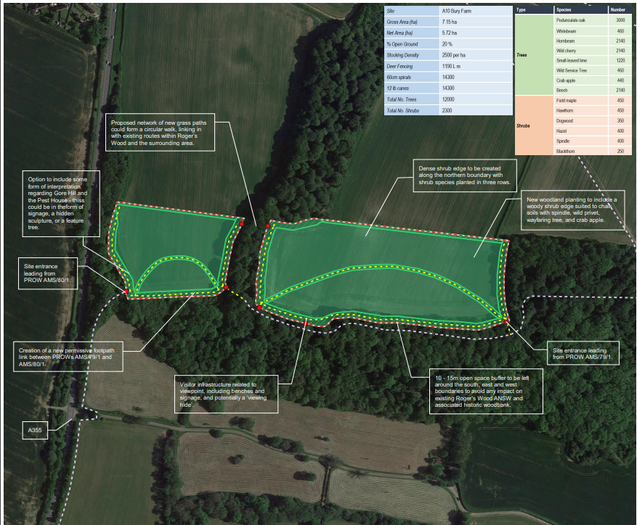
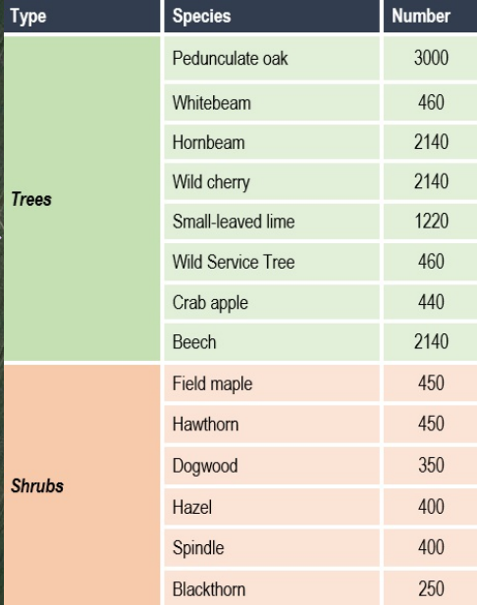
5. ‘22/’23 Projects and Beyond
Council Land Tree Planting Programme - Contractor Planting Model
Bury Farm (Amersham) – 7.15 ha; 14,300 trees

Slide 27
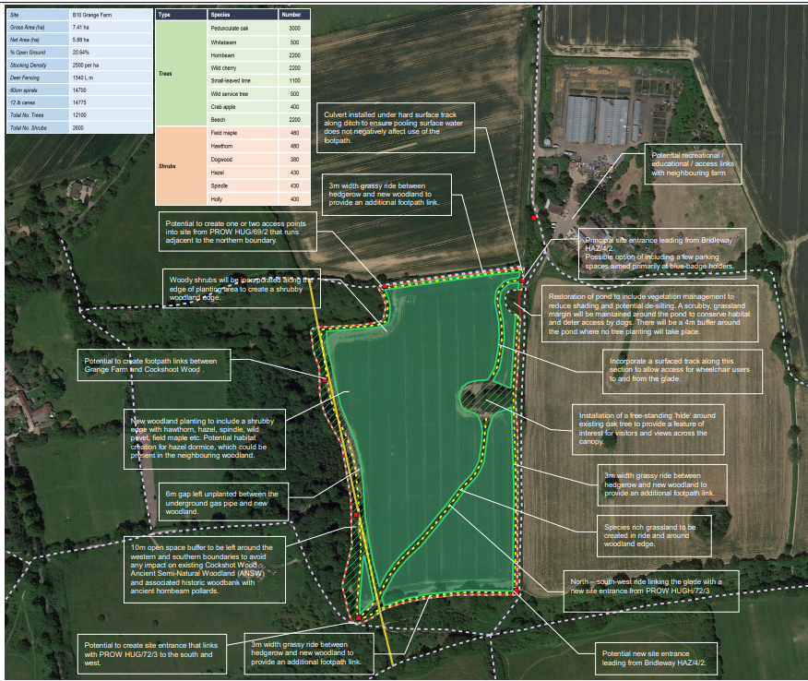
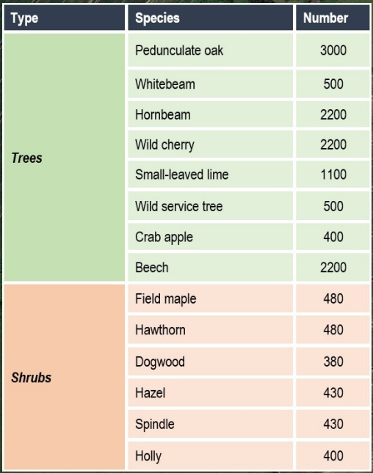
5. ‘22/’23 Projects and Beyond
Council Land Tree Planting Programme - Contractor Planting Model (cont.)
Grange Farm (Hazlemere) – 7.44 ha; 14,700 trees
Contractor planting cost of approx. £12-£13 per tree (after grant contributions)

Slide 28
5. ‘22/’23 Projects and Beyond
Facilitated Community Projects
LATF
Two Miyawaki (‘tiny forests’) woodland
creation projects (1,200 trees)
~30,000 stems per ha
large amount of ground preparation
claims that they can grow ten times faster
than other newly planted woodland
Cost of ~£48 per tree
Other part of the bid was for trees planted next to the public highway and other community sites (1,072 trees)
Standard trees specified for planting next to the public highway as they are robust enough for those environments
630 free trees to be given to 28 town and parish councils on 28th November
(N.B. donated from HS2)
Source: Bucks Radio

Slide 29
5. ‘22/’23 Projects and Beyond
Forestry England Woodland Partnership (FEWP) scheme
Tree establishment and maintenance is the responsibility of Forestry England
Public can access the newly forested sites
Landowner benefits from the Woodland Carbon Units generated
Rental income received from Forestry England (FE)
Site must be 50ha (but can be a smaller area if located close to FE operational sites)
Progress at the Wing site
Heads of Terms signed
Working on the lease
Planting expected across ‘22/’23 and ‘23/’24 planting seasons
Council cost per stem: ~£1.50

Slide 30
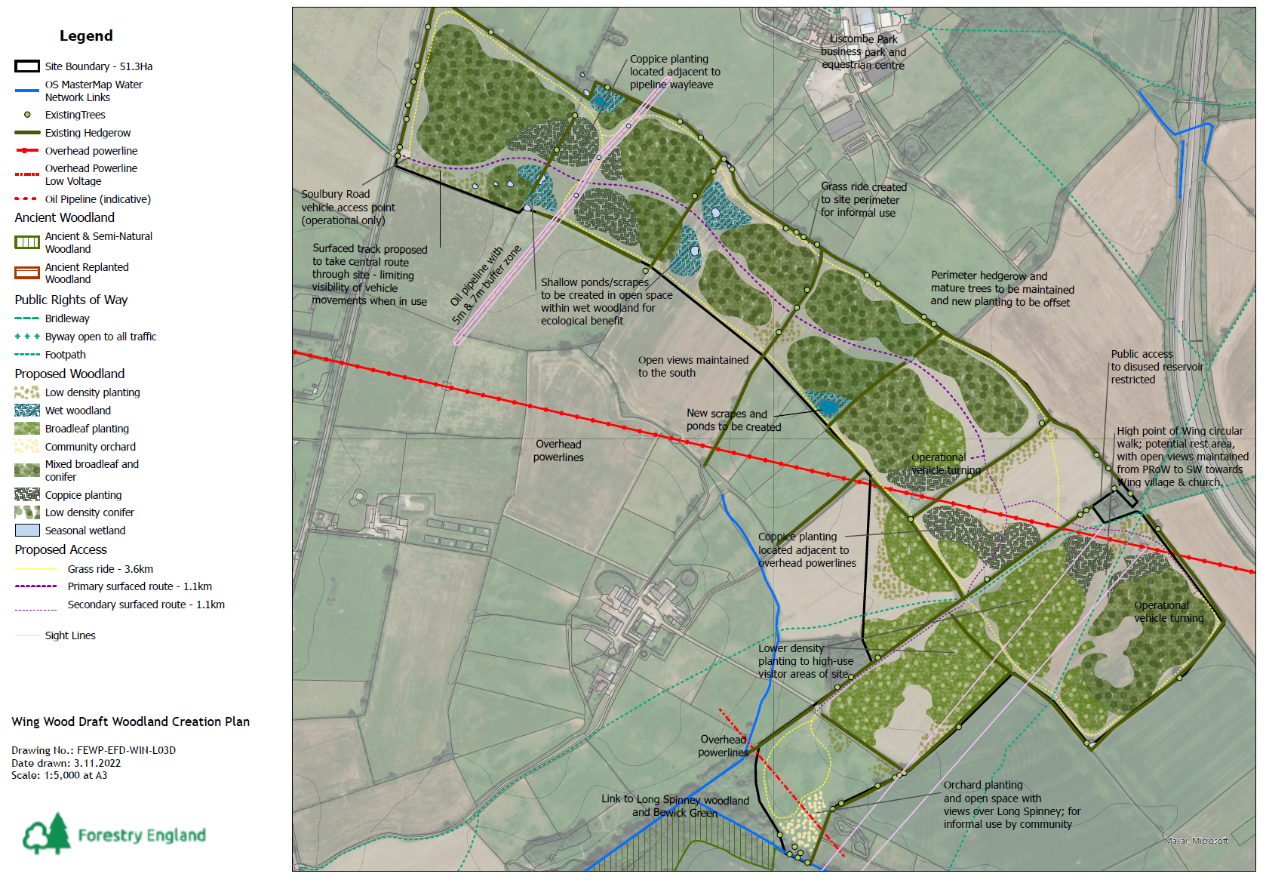
5. ‘22/’23 Projects and Beyond
Wing Woodland Creation Plan

Slide 31
5. ‘22/’23 Projects and Beyond
Human Resources
Principal Climate Change Officer dedicated to nature based solutions to climate change work (in post since the commitment to plant 543,000 trees)
Junior Climate Change Officer has assisted with community based tree planting activity (started in 2022)
£144k funding secured from the Woodland Creation Accelerator Fund (bid submitted in July 2022) for:
A Junior Woodland Creation Officer (‘23/’24) – to assist with site identification and evaluation work
A Senior Woodland Creation Officer (‘23/’24 and ‘24/’25) – to assist with progressing sites from design to planting stages

Slide 32
5. ‘22/’23 Projects and Beyond
Other Funding
Urban Tree Challenge Fund
80% funding for establishing trees in urban or peri-urban areas (including three years worth of maintenance)
Minimum UTCF funding of £10,000.
Closes on 30 June 2023
Woodland Creation Planning Grant
5ha min. area (can be made up of smaller blocks >0.5ha with >20m width)
Stage 1 grant: £1000
Stage 2 grant: £150 per ha (minus £1,000 offered at stage 1)
Supplementary payments for specialist survey work
Cap of £30k per project
Natural flood management funding

Slide 33
5. ‘22/’23 Projects and Beyond
Other work in 2022
Invitation to Quote for Woodland Creation Design Planning services to be issued
Buckinghamshire Tree Strategy under development
Extraordinary Payments for Replanting in Exceptional Circumstances (EPREC) grant claim payment (for trees affected at Billet Field)
Validation of projects registered with UK Land Carbon Registry

Slide 34
5. ‘22/’23 Projects and Beyond
Projected Carbon Benefit
Bury Farm
Grange Farm
Billet Field
Verification: years since start date | Vintage Start Date | Vintage End Date | Total PIUs in vintage to be listed (tCO₂e) | PIUs to Buffer (tCO₂e) | PIUs to Project (tCO₂e)
5 | 01 April 2023 | 31 March 2028 | 16 | 3 | 13
15 | 01 April 2028 | 31 March 2038 | 345 | 69 | 276
25 | 01 April 2038 | 31 March 2048 | 765 | 153 | 612
35 | 01 April 2048 | 31 March 2058 | 346 | 69 | 277
45 | 01 April 2058 | 31 March 2068 | 267 | 54 | 213
55 | 01 April 2068 | 31 March 2078 | 200 | 40 | 160
65 | 01 April 2078 | 31 March 2088 | 151 | 30 | 121
75 | 01 April 2088 | 31 March 2098 | 119 | 24 | 95
85 | 01 April 2098 | 31 March 2108 | 85 | 17 | 68
95 | 01 April 2108 | 31 March 2118 | 70 | 14 | 56
100 | 01 April 2118 | 31 March 2123 | 29 | 6 | 23
Total |  |  | 2393 | 479 | 1914
Verification: years since start date | Vintage Start Date | Vintage End Date | Total PIUs in vintage to be listed (tCO₂e) | PIUs to Buffer (tCO₂e) | PIUs to Project (tCO₂e)
5 | 01 April 2023 | 31 March 2028 | 13 | 3 | 10
15 | 01 April 2028 | 31 March 2038 | 339 | 67 | 272
25 | 01 April 2038 | 31 March 2048 | 778 | 156 | 622
35 | 01 April 2048 | 31 March 2058 | 347 | 69 | 278
45 | 01 April 2058 | 31 March 2068 | 268 | 54 | 214
55 | 01 April 2068 | 31 March 2078 | 202 | 40 | 162
65 | 01 April 2078 | 31 March 2088 | 153 | 31 | 122
75 | 01 April 2088 | 31 March 2098 | 119 | 24 | 95
85 | 01 April 2098 | 31 March 2108 | 86 | 17 | 69
95 | 01 April 2108 | 31 March 2118 | 70 | 14 | 56
100 | 01 April 2118 | 31 March 2123 | 31 | 6 | 25
Total |  |  | 2406 | 481 | 1925
Verification: years since start date | Vintage Start Date | Vintage End Date | Total PIUs in vintage to be listed (tCO₂e) | PIUs to Buffer (tCO₂e) | PIUs to Project (tCO₂e)
5 | 01 April 2022 | 31 March 2027 | 1 | 0 | 1
15 | 01 April 2027 | 31 March 2037 | 51 | 10 | 41
25 | 01 April 2037 | 31 March 2047 | 152 | 31 | 121
35 | 01 April 2047 | 31 March 2057 | 119 | 24 | 95
45 | 01 April 2057 | 31 March 2067 | 62 | 12 | 50
55 | 01 April 2067 | 31 March 2077 | 43 | 9 | 34
65 | 01 April 2077 | 31 March 2087 | 30 | 6 | 24
75 | 01 April 2087 | 31 March 2097 | 23 | 4 | 19
85 | 01 April 2097 | 31 March 2107 | 16 | 3 | 13
95 | 01 April 2107 | 31 March 2117 | 12 | 3 | 9
100 | 01 April 2117 | 31 March 2122 | 5 | 1 | 4
Total |  |  | 514 | 103 | 411

Slide 35
Resources
American University, Fact Sheet: Nature-Based Solutions to Climate Change
Nature Based Solutions Initiative, What is the Nature-based Solutions Initiative and what are nature-based solutions?
International Union for the Conservation of Nature (IUCN), Global Standard for Nature-based Solutions
Land Use Consultants, What are natural capital and ecosystems services?
FAO, Organic Agriculture
Defra, Enabling a Natural Capital Approach (2020)
The Guardian, Urban heat islands: cooling things down with trees, green roads and fewer cars
ScienceDirect, Atmospheric particulate matter accumulation on trees: A comparison of boles, branches and leaves
Bucks Free Press, Marlow Flood as River Thames Overflows
Notes:
Woodland Carbon Units have increased in value in the last couple of years from £10 t CO2e to £24 t CO2e abated. The Council will benefit from Woodland Carbon Units generated from sites planted and maintained by contractors or Forestry England under the Woodland Partnership Scheme.
The social benefits of visiting public woodland cannot be understated and have been valued at £3.96 per visit. Based on tools developed by Defra in relation to Natural Capital evaluations (March 2020), biodiversity benefits from woodland are valued at £588 per ha; flood water storage from woodland is valued at £115 per ha; and air pollution removal from rural and urban woodland are valued at £245 and £771 per hectare.

Slide 36
Resources
The Woodland Trust, Trees for Landowners and Farms
The Woodland Trust, Free trees for schools and communities
The Tree Council, Our Grants
Heart of Bucks, Apply for a Grant
Notes:
Woodland Carbon Units have increased in value in the last couple of years from £10 t CO2e to £24 t CO2e abated. The Council will benefit from Woodland Carbon Units generated from sites planted and maintained by contractors or Forestry England under the Woodland Partnership Scheme.
The social benefits of visiting public woodland cannot be understated and have been valued at £3.96 per visit. Based on tools developed by Defra in relation to Natural Capital evaluations (March 2020), biodiversity benefits from woodland are valued at £588 per ha; flood water storage from woodland is valued at £115 per ha; and air pollution removal from rural and urban woodland are valued at £245 and £771 per hectare.

